Slide 1
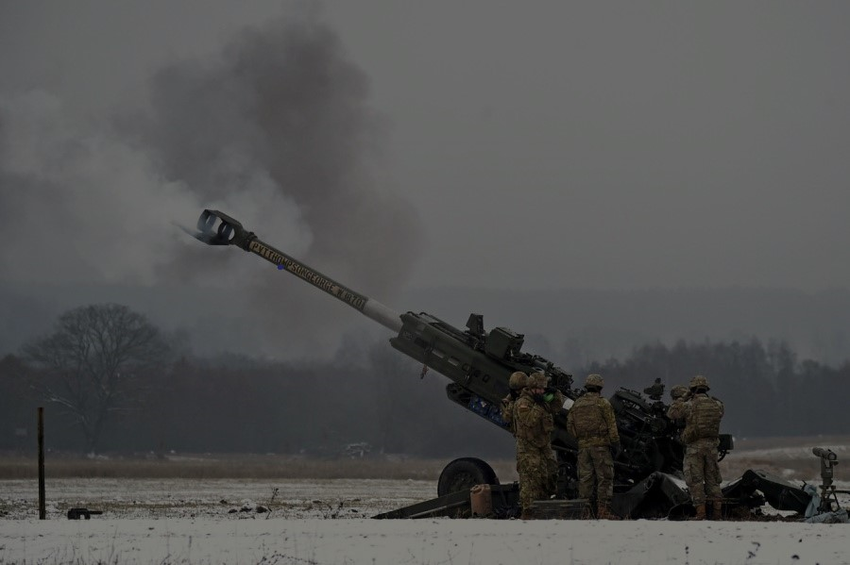
FORT CAMPBELL
U.S. ARMY WARRANT OFFICER
VIRTUAL BRIEFING
The Central Warrant Officer Recruiting Team will be conducting a virtual briefing on qualification and application procedures to become an Army Warrant Officer !
DATE & TIME LOCATION
Thursday April 10th 2025/ 1200-1300 Click here to join the meeting
POINTS OF CONTACTS
CW3 Shimeara C. Perkins - shimeara.c.perkins.mil@army.mil - 931-250-2159
CW3 Timothy J Cox - timothy.j.cox52.mil@army.mil-910-303-5027
SFC William H. Carter- william.h.carter74.mil@army.mil 254-266-3613

