Slide 1



















Warrant Officer Applicant Brief
52 Specialties – 17 Branches
U.S. ARMY
WARRANT OFFICER
RECRUITING
1918
Subject Matter Experts Since
WWW.GOWARRANTNOW.COM

Slide 2







Warrant Officer Recruiting Mission
The Warrant Officer Recruiting Company is tasked with recruiting highly qualified in-service applicants who demonstrate character, competence, and commitment to serve as capable active duty Army Warrant Officers.

Slide 3
Terms of Reference
Technicians
Usually, SGT or higher
Most require completion of ALC
Meet MOS prerequisites
17 Branches, 52 Specialties
Aviators
1 Specialty - 153A
Open to all MOSs and ranks
Passing SIFT Score - 40+
Class I Flight Physical

Slide 4
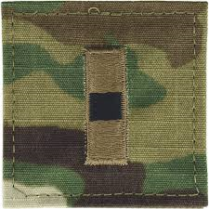
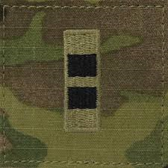
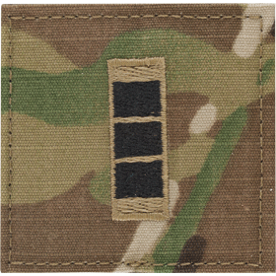
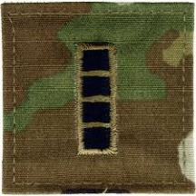
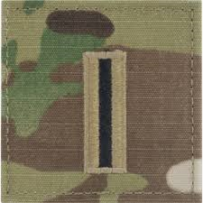
Define a Warrant Officer
DA Pam 600 - 3
The Army Warrant Officer is a self-aware and adaptive technical expert, combat leader, trainer, and advisor. Through progressive levels of expertise in assignments, training, and education, the WO administers, manages, maintains, operates, and integrates Army systems and equipment across the full range of Army operations. WOs are innovative integrators of emerging technologies, dynamic teachers, confident warfighters, and developers of specialized teams of Soldiers. They support a wide range of Army missions throughout their careers.
WO1
Basic level
CW2
Intermediate
CW3
Advanced
CW4
Senior
CW5
Master

Slide 5















Applicant Characteristics
Independent Operator
Leader
Self Confident
Dependable
Ethical and Moral
Decision Maker
Self Sufficient
Mature
Complex Problem Solver
Mentally and Physically Strong

Slide 6
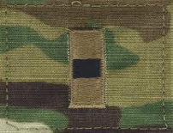
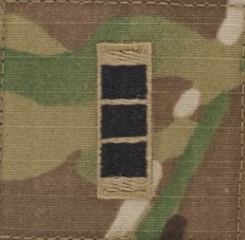
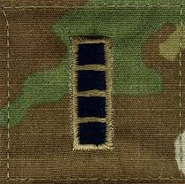

Promotion Timeline
Technicians
153A / 170D
2 years TIG
2 years TIG
4-5 years TIG
5-6 years TIG
4-5 years TIG
5-6 years TIG
4-5 years TIG
5-6 years TIG

Slide 7











Extended Career
Total Years Active Federal Service
30 + Years of WO SVC
*Continued Promotion / Age 62
30 Years
1SG(P) / MSG(P) and CSM/SGM
26 Years
1SG/MSG
24 Years
SFC
20 Years
SSG

Slide 8
Base Pay Comparison
APPROX SNAPSHOT
E-5 vs W-1 at 6 years TIS = $1200
E-6 vs W1 at 10 years TIS = $990
E-7 vs W1 at 16 years = $544
2025 Pay Scale

Slide 9
MILITARY RETIRMENT PAY
Notes:
Retired Pay Multiplier
For both the Final Pay and High-36 retired pay plans, each year of service is worth 2.5% toward the retirement multiplier. For example, 20 years of service would equal a 50% multiplier. The years of service creditable are computed differently depending upon whether retirement is from full time active duty or from a reserve career. These differences are explained under the Active Duty Retirement and Reserve Retirement pages.
For the REDUX retirement plan, which applies only to certain active duty retirements as described above, the High-36 multiplier is reduced by one percentage point for each year that the member has less than 30 years of service at retirement. For example, 20 years of service would equal a 40% multiplier. This is discussed more fully under the Active Duty Retirement page.
For disability retirement programs, the multiplier will be the higher of (a) the disability percentage assigned by the Service at retirement not to exceed 75%, or (b) the result of multiplying the number of years of service by the applicable retirement plan multiplier (e.g., 2.5% for High-36 or 2.0% for BRS).
In any case, the longer an individual serves, the higher the multiplier and the higher the retirement pay. For example:
Please reference Retirement (defense.gov)

Slide 10
Aviation Incentive Pay
$125
Over 2 Years
$200
Over 10 Years
Over 6 Years
$700
$1000
Under 2 Years

Slide 11
Sea Pay
WO1
CW2
CW4 & CW5
CW3
$210 - $695 per month
$210 - $730 per month
$210 - $625 per month
$182 - $555 per month
Notes:
IAW AR 600-88
SEA PAY IS GIVEN WHILE ASSIGNED TO A VESSSEL (SEA TIME)
THE AMOUNT IS BASED ON RANK AND TOTAL SEA TIME
A WO1 WITH ZERO SEA TIME STARTS AT $182 PER MONTH A CW2,CW3, OR CW4 WITH ZERO SEA TIME STARTS AT $210 PER MONTH
THE AMOUNT PER MONTH GROWS INCREMENTALLY BASED ON TOTAL YEARS OF SEA TIME, WILL INCREASE WHEN A HIGHER RANK IS ACHIEVED
THE MAX IS $730 PER MONTH AS A CW5 WITH OVER 14 YEARS TOTAL SEA TIME

Slide 12

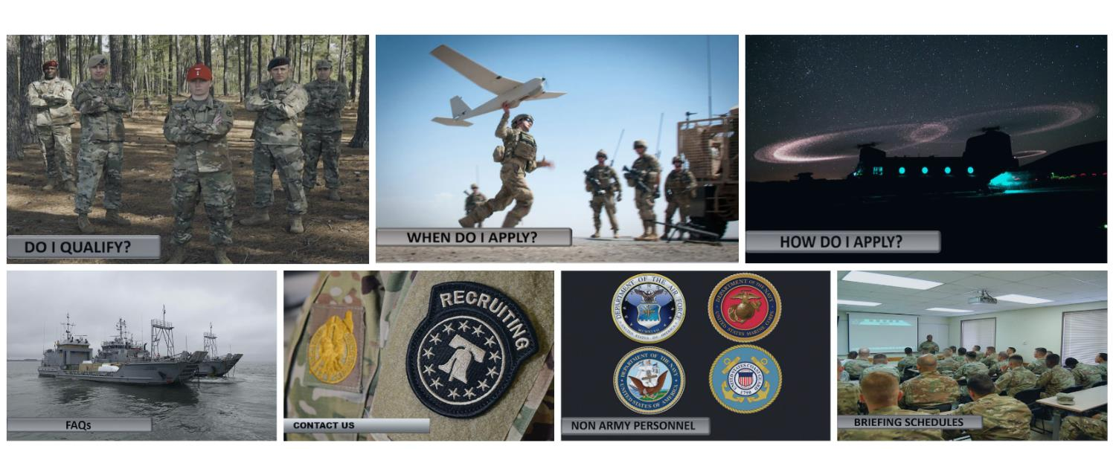
Where to Begin
www.gowarrantnow.com

Slide 13
Administrative Requirements
US Citizenship No Waiver
General Technical (GT) Score of 110 or higher No Waiver
High School Graduate or have a GED No Waiver
Adjudicated Secret or Top-Secret Security Clearance No Waiver
Have ≥ 12 months remaining on enlistment contract *ETP Avail
Pass Commissioning Physical for Tech or Flight Physical for Aviators *Waiver/ETP Avail
Technicians: Age < 46 years when pin WO1 / Active Federal Service < 12 years at time the DA 61 is signed by applicant *ETP Avail
Aviators: Age < 33 years at time packet is boarded / Active Federal Service < 8 years at time the DA 61 is signed by applicant *ETP Avail
Pass standard 5 event AFT and meet height & weight standards IAW AR 600-9.

Slide 14
Warrant Officer MOSs
WO MOS MOS Description Enlisted Feeder MOSs
120A Construction Engineering Technician 12H, K, N, P, Q, R, T, W
125D Geospatial Engineering Technician 12Y
131A Field Artillery Technician 11B, C,13B, J, F, M, R, 19D, K
140A Command and Control Systems Technician 14E, G, H, P, S, 15P, Q, 17E
140K Air and Missile Defense Tactician 14E, H, T
140L Air and Missile Defense Technician 14E, H, T, 94S
150A Air Traffic and Air Space Management Technician 15Q
150U Tactical Unmanned Aerial Systems Technician 15C, 15E, 15M, 15W
151A Aviation Maintenance Technician CMF 15 MOS (Except 15P, Q)
153A Rotary Wing Aviator All MOSs
170A Cyber Operations Technician All MOSs
170B Electromagnetic Warfare Technician All MOSs
170D Cyber Capabilities Developer Technician All MOSs
180A Special Forces Warrant Officer All CMF 18 MOS
255A Data Operations Warrant Officer All MOSs
255N Network Operations Warrant Officer All MOSs
255S Cyberspace Defense Warrant Officer All MOSs
270A Legal Administrator 27D, 42A, 36B, 51C
280A Software Operations Technician All MOSs
311A CID Special Agent All MOSs
350F All Source Intelligence Technician 35F
350G GEOINT Imagery Technician 35G
351L Counterintelligence Technician 35L
351M Human Intelligence Collection Technician 35M
Critical Mission
Open to ALL MOSs provided prerequisites are met

Slide 15
Warrant Officer MOSs
WO MOS MOS Description Enlisted Feeder MOSs
351Z Attaché Intelligence Operations Technician All MOS with SQI 7
352N SIGINT Analysis Technician 35N, P, S
352S Signals Collection Technician 35S
353T MI Systems Maintenance/Integration Technician 35T
390A Robotics Technician All MOS
420A Human Resources Technician 42A
420T Talent Acquisitions Technician 79R; All MOSs
420C Bandmaster All CMF 02 MOS’s, 42R, 42S
740A Chemical, Biological, Radiological and Nuclear Tech 74D
880A Marine Deck Officer All MOSs
881A Marine Engineering Officer All MOSs
882A Mobility Officer All MOSs
890A Ammunition Warrant Officer 89A, B, D
913A Armament Systems Maintenance 91A, F, M, P
914A Allied Trades Warrant Officer 91E, X
915A Automotive Maintenance Warrant Officer 91B, C, D, J , X
915S Stryker Maintenance Warrant Officer 91B, S, X
915T Track Maintenance Warrant Officer 91A, H, L, M, P, X
919A Engineer Equipment Maintenance Warrant Officer 91H, L, X
920A Property Accounting Technician 92Y
920B Supply Systems Technician 92A, 68J
921A Airdrop Systems Technician 92R
922A Food Service Technician 92G, 68M
923A Petroleum Systems Technician 92F, L, W
948B Electronic Systems Maintenance 94D, E, F, H, M, R, W, Y, Z
948D Electronic Missile Systems Maintenance 94A, M, P, S, T, X, Z

Slide 16
Board Schedule
www.gowarrantnow.com

Slide 17
Packet Submission Deadlines
Board Dates | New Packet Deadline | Corrections Deadline | Updates Deadline
17-21 Nov 25 | 22 Sep 25 | 06 Oct 25 | 03 Nov 25
26-30 Jan 26 | 17 Nov 25 | 01 Dec 25 | 29 Dec 26
23-27 Mar 26 | 26 Jan 26 | 09 Feb 26 | 09 Mar 26
11-15 May 26 | 16 Mar 26 | 30 Mar 26 | 20 Apr 26
27-31 Jul 26 | 25 May 26 | 15 Jun 26 | 06 Jul 26
21-25 Sep 26 | 27 Jul 26 | 10 Aug 26 | 07 Sep 26
Deadline verification, extensions, and changes announced on www.gowarrantnow.com
Failure to meet deadlines may delay packet to a later selection board
Applicants requiring waiver(s)/ETP(s) must plan for early packet submission

Slide 18
Application Documents
www.gowarrantnow.com

Slide 19
The Application
Board Packet Supporting Documents
1. DA Form 61
2. USAREC Form 3.3
3. USAREC Form 3.2
4. Soldier Talent Profile or Equivalent
5. Evaluations (Newest to oldest)
6. AERs/1059s (Newest to oldest)
7. College Transcripts
8. Professional Certificates (If applicable)
9. SIFT Score Sheet (153A only)
1. Security Clearance Verification Memo
2. USAREC Form 3.1
3. DA Form 160
4. Statement of Understanding
5. Approved DD Form 368 (NG/USAR/IS only)
6. REDD Report (Interservice only)
7. Tattoo Validation Memo (Interservice only)
8. Waiver/ETP Requests (w/ supporting documents)
9. DA Form 705
10. DA Form 5500 / 5501 (If applicable)
11. Checklist (S1 OIC/HR Tech and SWO signatures)

Slide 20
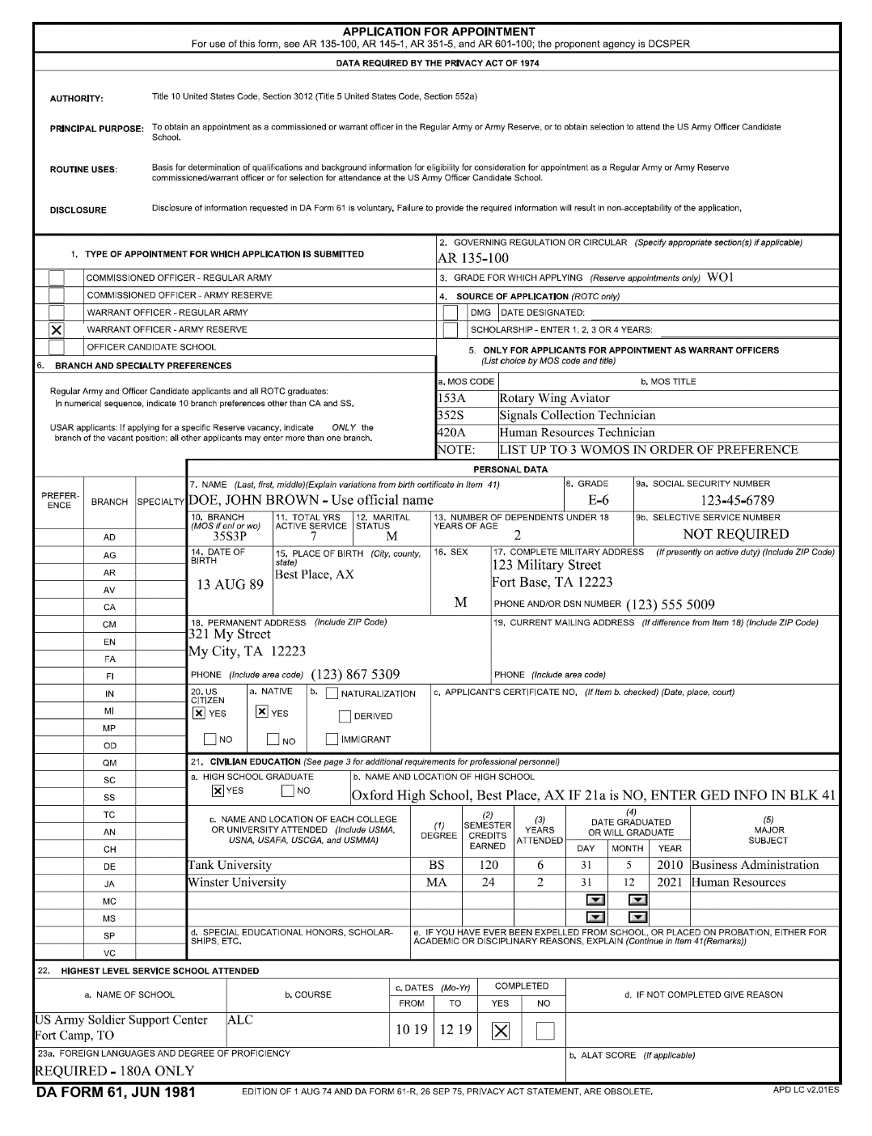
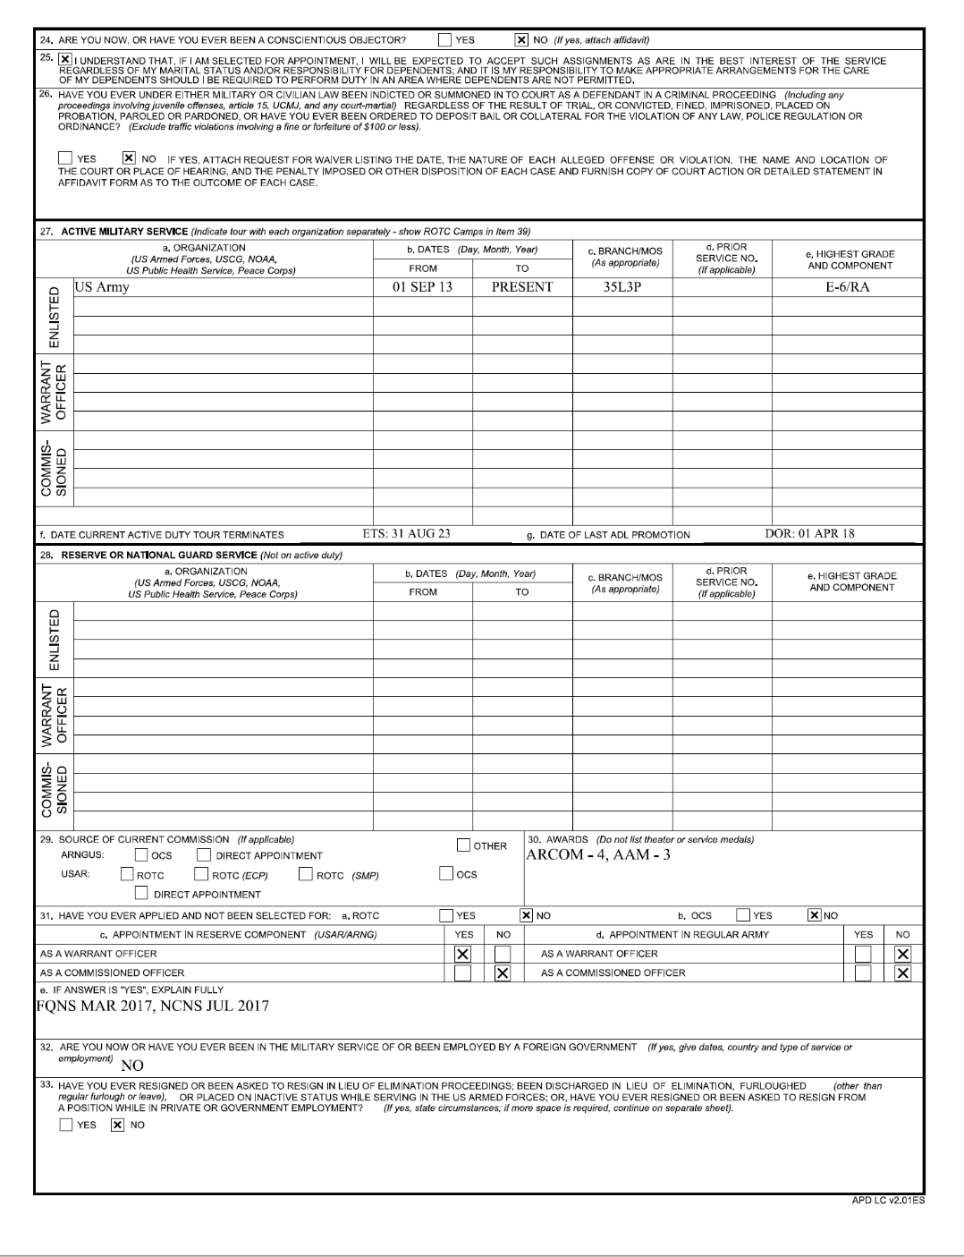
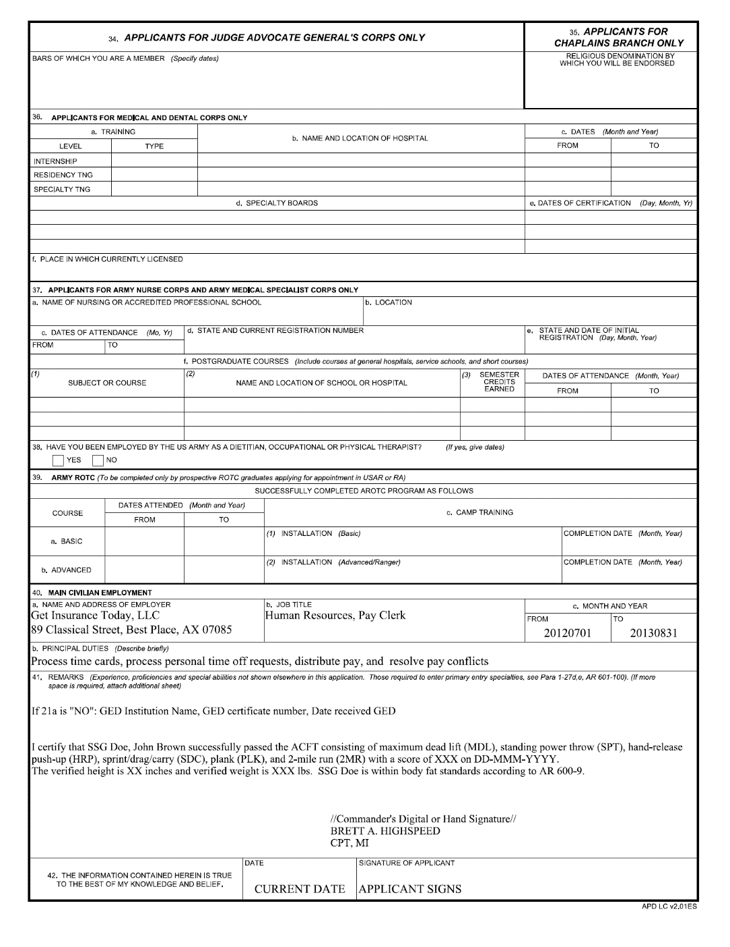
Application for Appointment
DA Form 61
Applicant must sign
Unit Commander must sign verifying ACFT & Ht/Wt

Slide 21
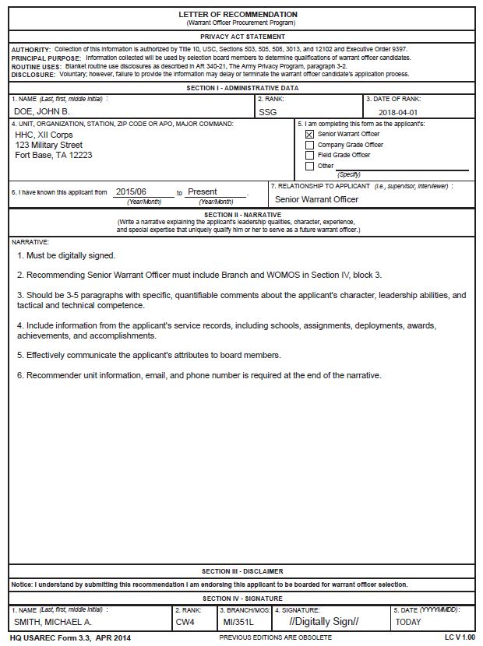
Letter of Recommendation
USAREC Form 3.3
  All applicants require at a minimum 3 LORs
      First and Second level UCMJ authorities
      Senior Warrant Officer
  3 Supplemental LORs allowed (max for LORs is 6)
  SWO must include Branch/MOS
  LORs are valid for 12 months from date of signature/ 90 days upon unit arrival (PCS)
  Must be digitally signed
  Joint or unique organization LOR ETP available

Slide 22
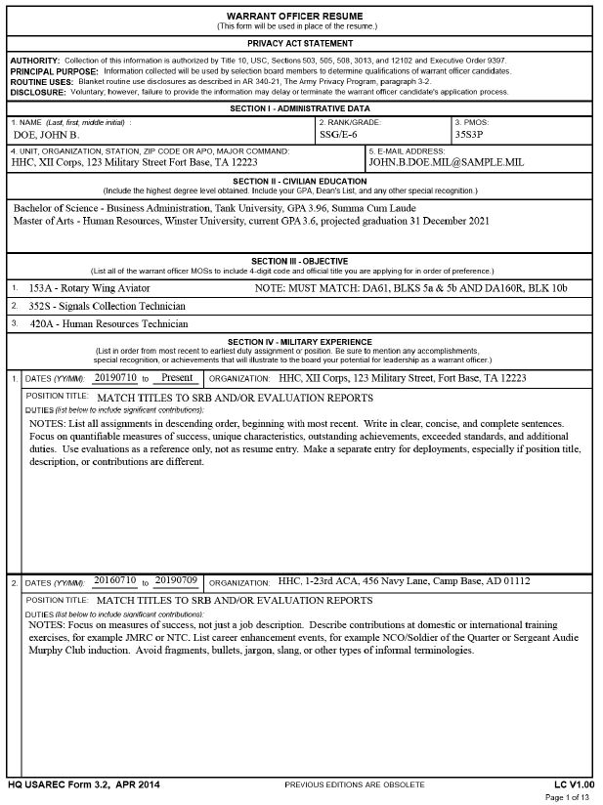
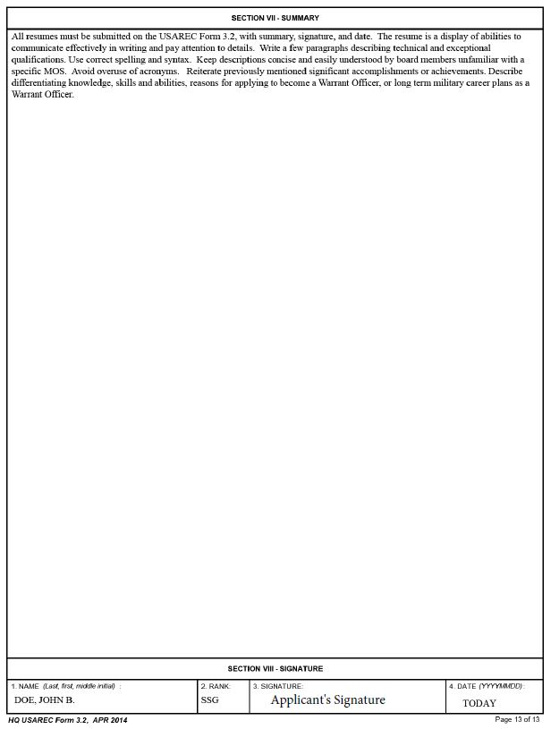
Resume
USAREC Form 3.2
- Why are you qualified to be an Army Warrant Officer?
- Why are you qualified to be an Army Aviator, HR Technician, Logistician?
- What will you contribute to the Army as a Warrant Officer?
- Why do you want to be an Army Warrant Officer?
Applicants Signature
Date

Slide 23
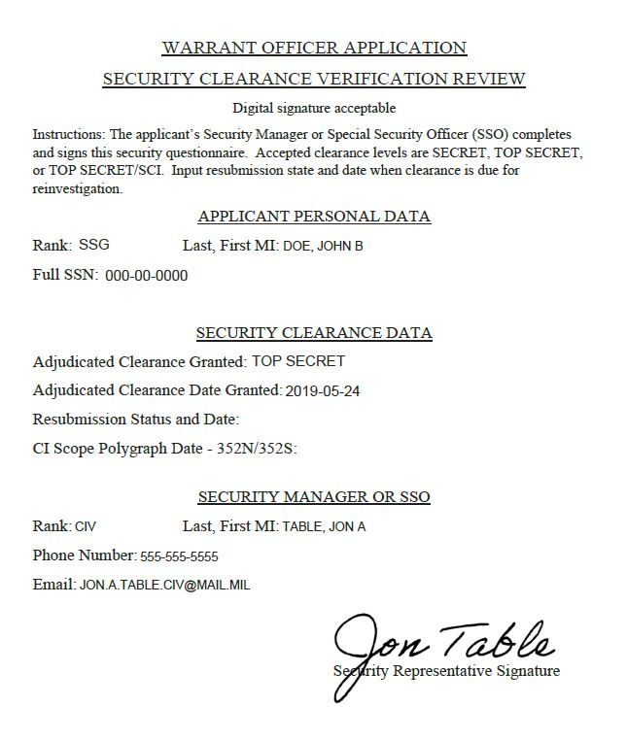
Security Clearance Verification
Complete fillable version
SECRET valid for 10 yrs from date granted
TOP SECRET valid for 6 yrs from date granted
Resubmission Status and Date required if clearance is due for reinvestigation.
  Example - Enrolled in CE 23 Jan 2021
  Example - PR Submitted 23 Jan 2021

Slide 24
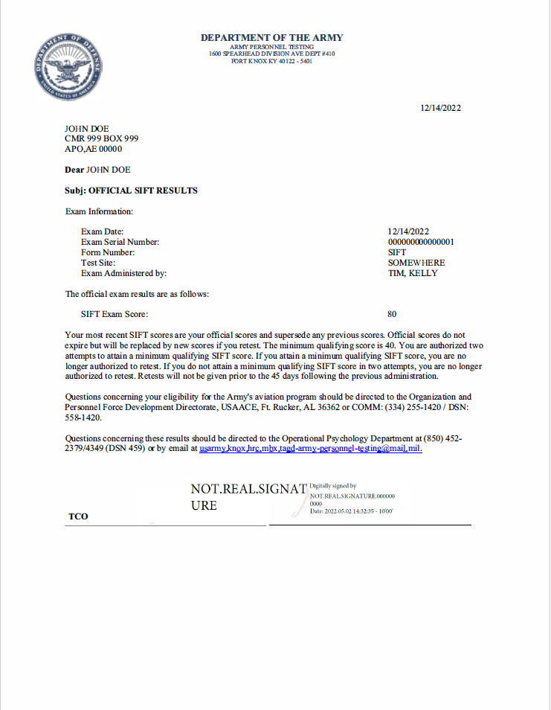
SIFT
Selection Instrument for Flight Training
Must Score 40 or Higher
Lifetime score; once meeting minimum qualifying score you are no longer authorized to retake
If you fail to attain minimum passing score on first attempt, you may retake SIFT no earlier than 46 days following the previous attempt
If you fail to attain a passing score on second attempt, you are no longer authorized to retake the SIFT
Must have passing SIFT score before scheduling Class I Flight Physical
Must be signed by the Test Control Officer (TCO) / Test Examiner (TE) to be valid

Slide 25
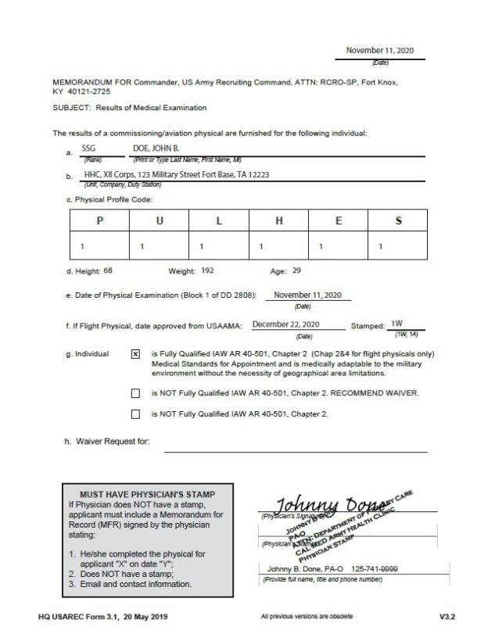
Physical Cover Sheet
USAREC Form 3.1
150A/153A: line f must be completed
150A/153A: must include stamped DD 2808 page 1
Technical MOS with medical waiver follow instructions on website
Must include physician stamp
  Physicians without a stamp must include a MFR

Slide 26
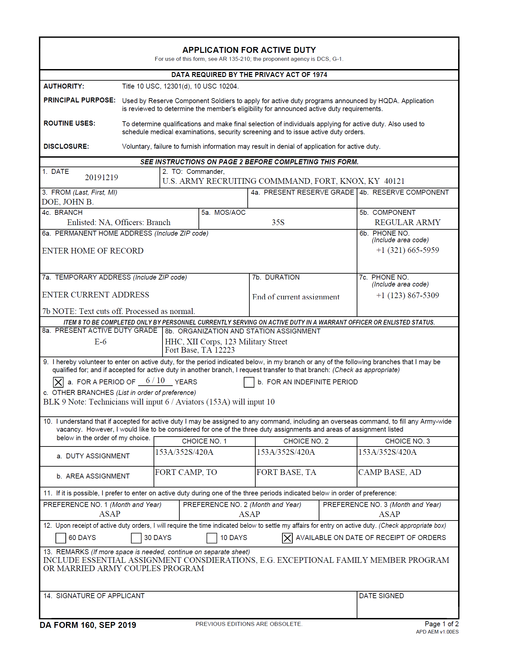
Application for Active Duty
DA Form 160

Slide 27
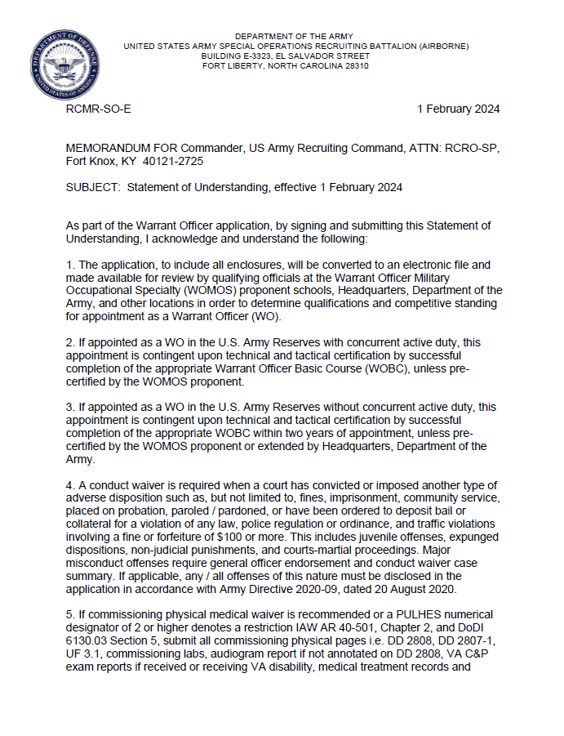
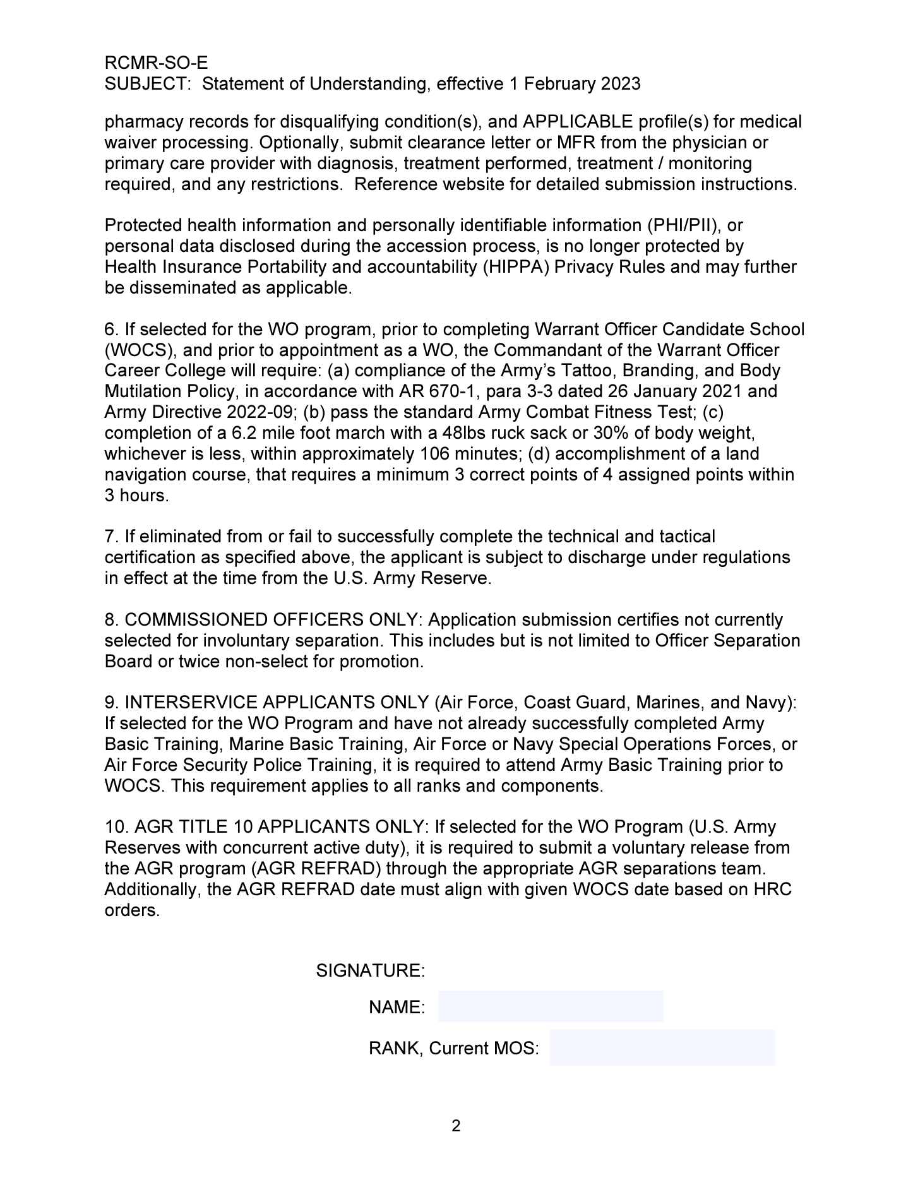
Statement of Understanding

Slide 28
Waiver / ETP Requests
WAIVER / ETP | APPROVAL AUTHORITY | APPROX TURN AROUND TIME | NOTES
Age / AFS | DA G1 | 2 - 4 Weeks | Self Signed Memo
Prerequisite | Proponent | 1 - 2 Weeks | Self Signed Memo
Medical | USAREC G3 | 4 - 8 Weeks | Submit docs to WORC
Medical Review | USAREC G3 | 4 - 8 Weeks | Submit docs to WORC
Tattoo | USAREC CG | 1 - 3 Weeks | Self Signed Memo / LTC Signed Memo / Color photos with ruler
Traffic / Conduct | SORB BN CDR | 1 - 2 Weeks | Self Signed Memo
Major Conduct | DA G1 | 4 - 6 Weeks | Self Signed Memo / GO Endorsement / Case Summary
AFT | DA G3 | Unknown | Approved prior to submission

Slide 29
Tattoo Guidance IAW
Army Directive 2022-09
    One tattoo on each hand or palm, not to exceed one inch in all directions
    Unlimited number of tattoos between the fingers, if not visible when fingers are closed
    One ring tattoo on each hand
    One tattoo on the back of the neck, not to exceed two inches in all directions
    One tattoo behind each ear that does not extend forward of the ear lobe, not to exceed one inch all directions

Slide 30
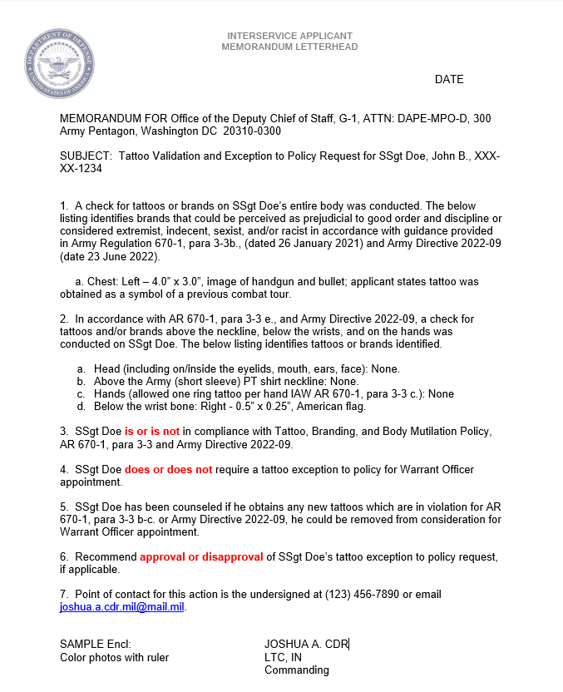
Tattoo Compliance Validation
Interservice Applicants Only

Slide 31
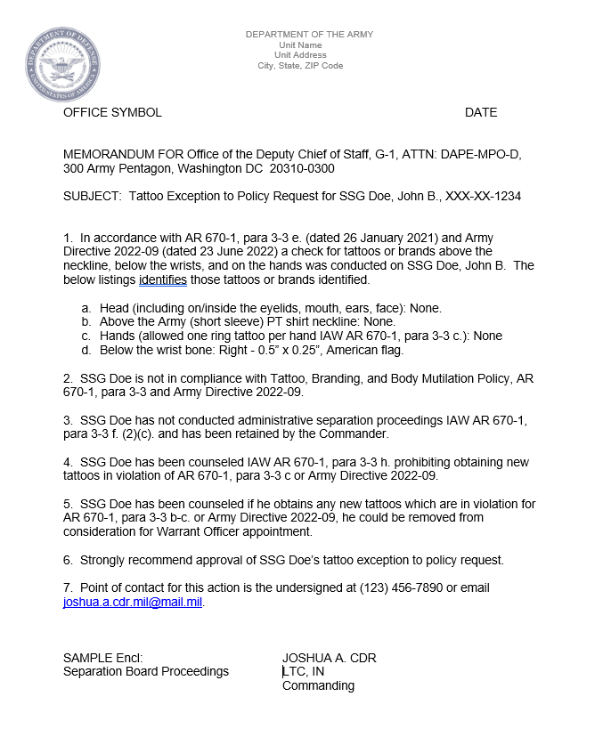
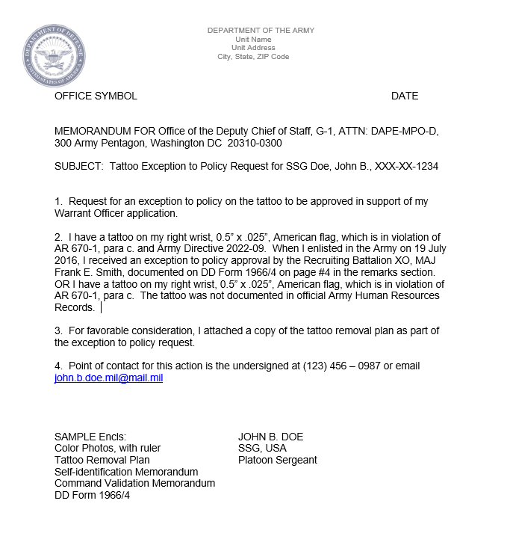
Tattoo ETP Request
Army Applicants Only

Slide 32
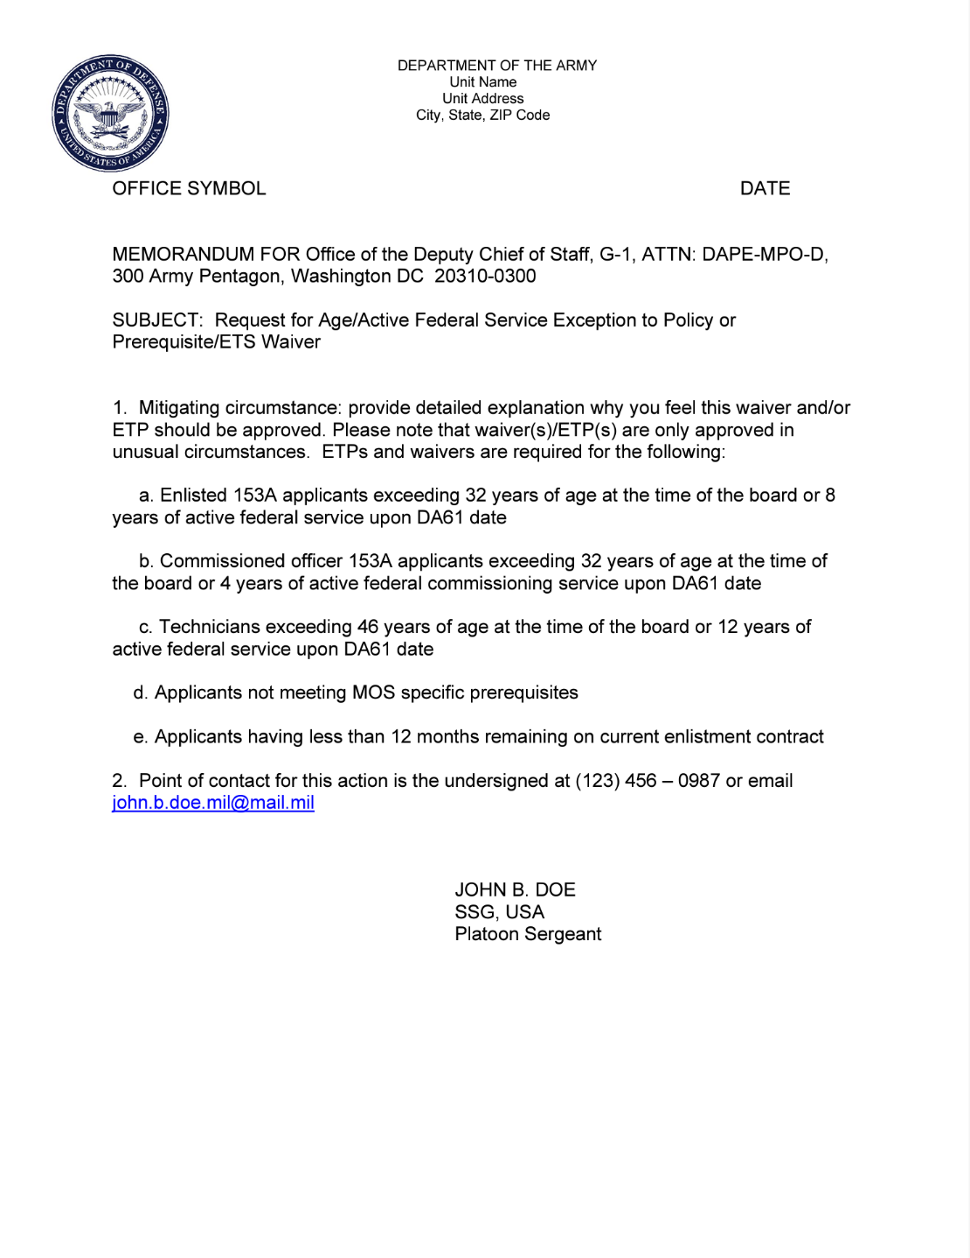
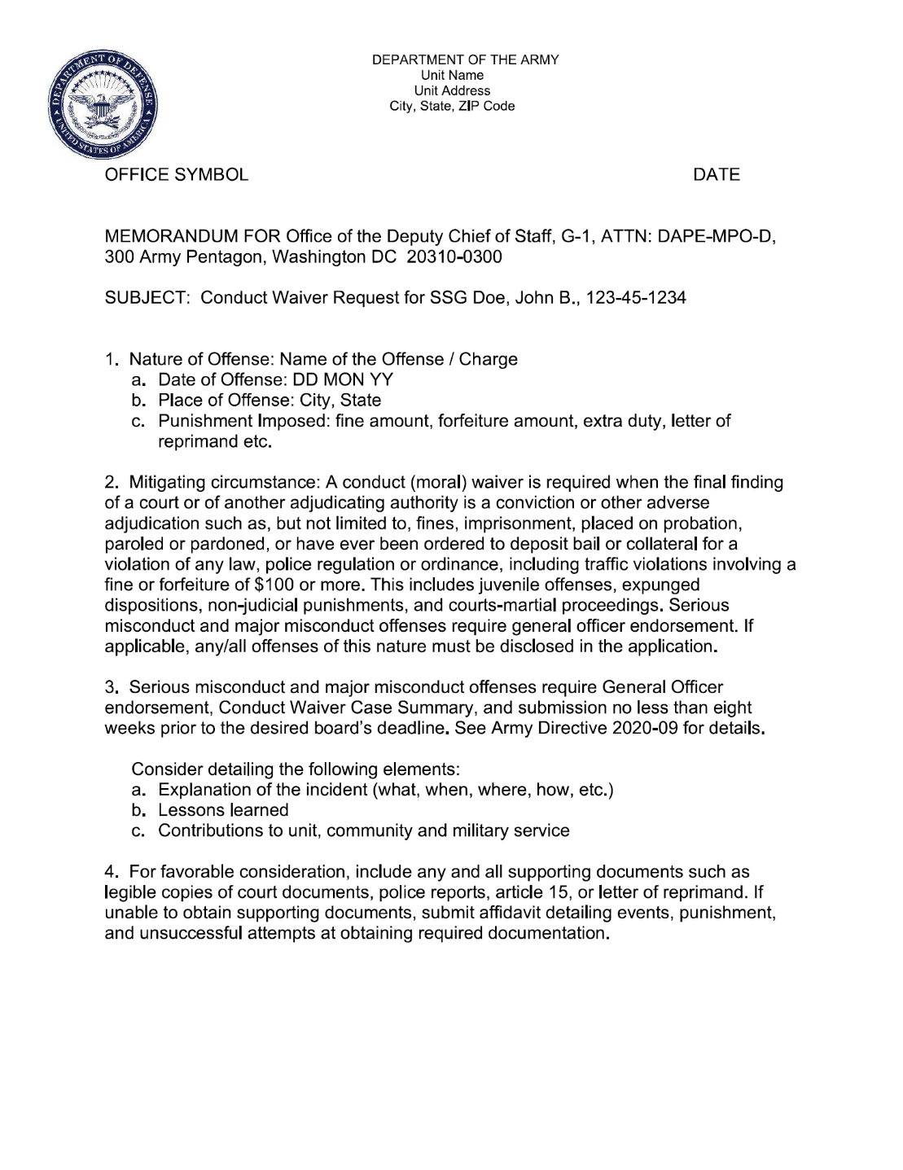
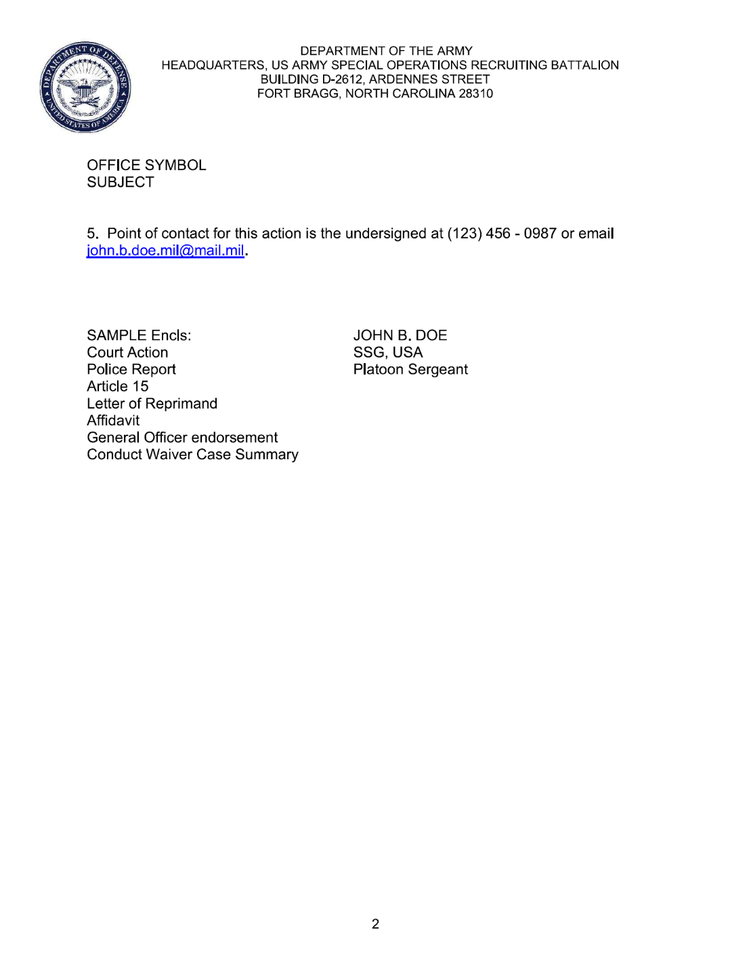
ETP and Waiver Requests

Slide 33
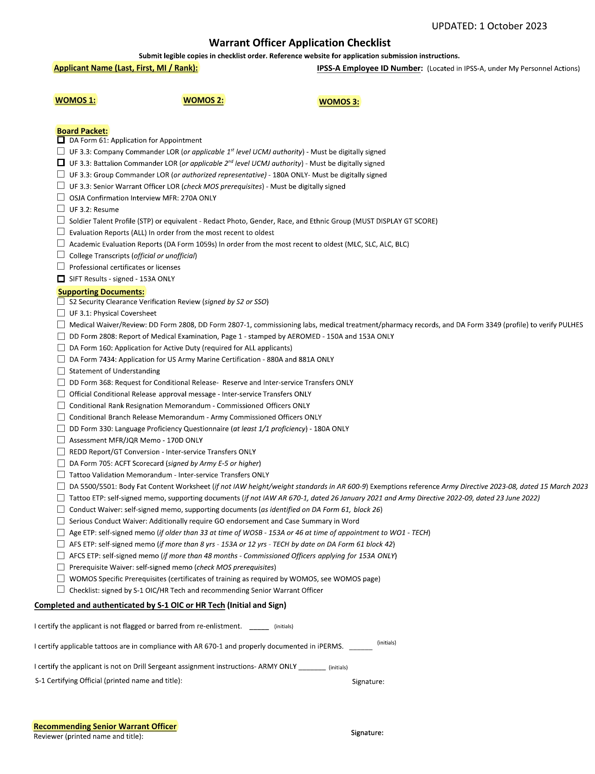
Application Checklist
Notes:
Use checklist as a guide for the proper order of application when submitting
S1 OIC/HR Tech (or equivalent)
Verifies not flagged/barred
Confirms tattoo documentation ICW AR 670-1
Administrative review
Verify not on DS Duty
Recommending SWO
Final application review

Slide 34
Application Process
Prerequisite
Waivers
Approved by
Proponent
Medical
Waivers
Approved by
USAREC CMD
Surgeon
APPLICANT
Level 1
WORC
Administrative
Qualification
Level 2
Proponent
Technical
Qualification
Level 3
USAREC
Regulatory
Qualification
Board Ready
Corrections
Required
Conduct/Traffic
Waivers
Approved by
SORB BN CDR
AFS, Age
Major
Misconduct
Waivers
Approved by
DA G-1
Tattoo
Waivers
Approved by
USAREC CG

Slide 35
Selection Board Notes
Results published via MILPER message 7-10 business days after WOSB concludes
Fully Qualified packets boarded twice
Fully Qualified - Select instructions and information disseminated via email 45-90 days after publication of MILPER message
Non Competitive - Non Select must wait 12 months from initial DA 61 date to resubmit application
USAREC G3 will no longer send emails notifying applicants of selection or non-selection status. MILPER message will be the exclusive form of official selection notification

Slide 36
Applicant Key Points
Maintain situational awareness of application requirements; check website for current forms and documents
Direct MOS specific questions, conversion / technical qualifications and SWO LOR to respective proponent POC
Follow application submission instructions and naming conventions; ensure application not encrypted
Contact a recruiter for application status every 10 -14 days until application is board ready
AR/NG/IST - Conditional Release must be approved prior to application submission
IST Only - Request REDD Report / GT Conversion from recruiter

Slide 37
Contact Us
52 SPECIALTIES – 17 BRANCHES
www.gowarrantnow.com

Slide 38






Warrant Officer Recruiting Company
WO - WEST
CW2 Mulkern 131A
SFC Lermy 42T
SFC Wold 25H
SSG Bado 91C
Alaska
Ft Lewis
WO - CENTRAL
CW3 Cox 420A
Ft Drum
WO – NORTHEAST
CW2 McNair 920A
SFC Walker 42T
SSG Mcdonald 35M
Ft Carson
Ft Riley
Ft Belvoir
WO – EAST
CW2 Ensinger 740B
SSG Rotz 35F
SSG Fane 42A
DLI
NTC
Ft Sill
Ft Campbell
Ft Bragg
Ft Huachuca
Ft Benning
Ft Jackson
Ft Bliss
Ft Hood
Schofield Barracks
Ft Polk
Ft Stewart
Company HQ
CDR - CW4 Frye 120A
1SG – 1SG Swiger 79R
XO- CW3 Rodriguez 914A
Korea
WO – SOUTHEAST
CW2 Collins 420A
SFC Covarrubias 42T
Japan
WO - SOUTHWEST
CW3 Polite 120A
SFC Robinson 42T
SFC Holcomb 42T
SFC Wahl 42A
WO – PACOM
CW3 Meyers 913A
SFC Horne 42T
SSG Gaston 42A
Italy
Germany
CENTCOM
WO – EUCOM
CW2 Lucio 153A
SFC Skelton 42T
Notes:
The Warrant Officer Recruiting Company would like to express our sincerest gratitude for your support and efforts. As vital members of the accession's enterprise, your responsiveness and collaboration are pivotal to every event, whether in person or online, and mission success. Your contributions enable this company to remain motivated and accurately representative the cohort’s diversity to all service branches and components.

Slide 39
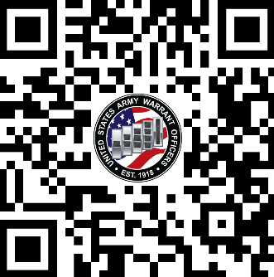
Questions
www.gowarrantnow.com
https://www.facebook.com/GoWarrant/

