Slide 1
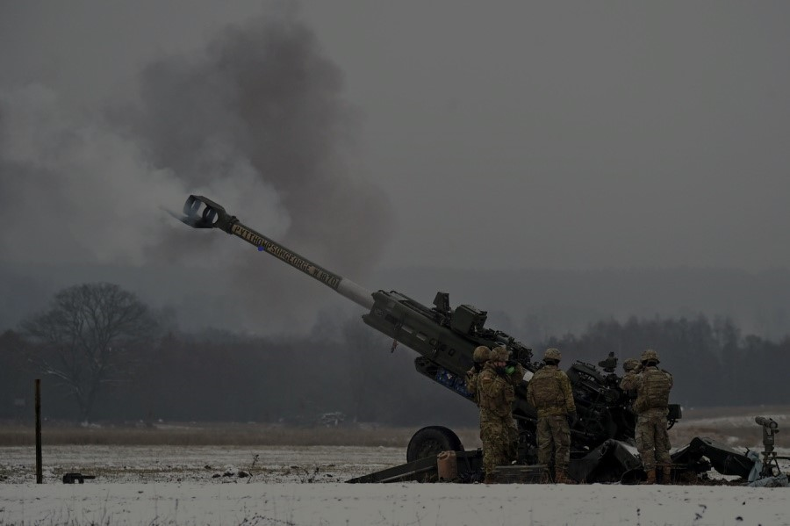
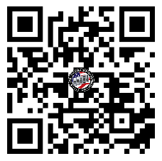
FEBRUARY FORT LIBERTY
U.S. ARMY WARRANT OFFICER
BRIEFING
The U.S. Army Warrant Officer Recruiting Team will be in your area to conduct briefings on qualification and application procedures to become an Army Warrant Officer.
DATE & TIME LOCATION
Thursday, February 6th, 2025
&
Thursday, February 20th, 2025
@ 1330 - 1430
Education Center Room F-116
4520 Knox St.
Fort Liberty, NC 28310
Packet Process:
POINT OF CONTACT
SFC Paige, Johnnie - (910) 308 - 0680 - johnnie.m.paige.mil@army.mil
SSG Rotz, Alexander - (910) 551-1004 - Alexander.j.rotz.mil@army.mil

