Slide 1
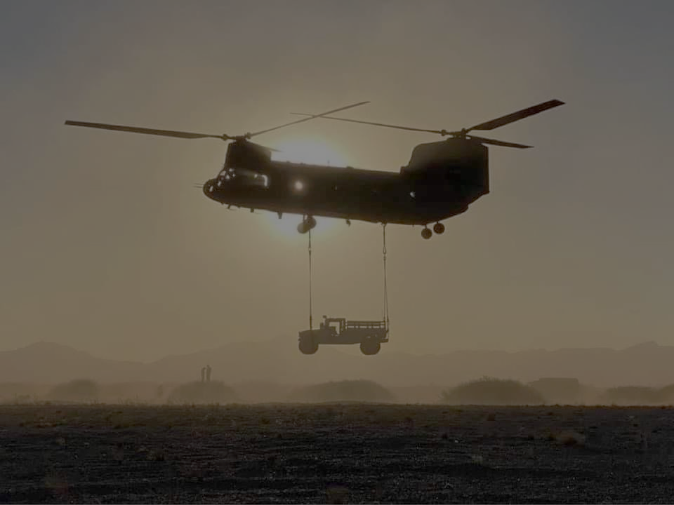
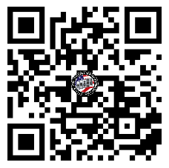
JULY FORT BRAGG
U.S. ARMY WARRANT OFFICER
BRIEFING
The U.S. Army Warrant Officer Recruiting Team will be in your area to conduct briefings on qualification and application procedures to become an Army Warrant Officer.
DATE & TIME LOCATION
Thursday, July 10th , 2025
&
Thursday, July 24th , 2025
@ 1330 - 1430
Education Center Room F-116
4520 Knox St.
Fort Bragg, NC 28310
Packet Process:
POINT OF CONTACT
WO1 Paige, Johnnie - (910) 308 - 0680 - johnnie.m.paige.mil@army.mil
SSG Rotz, Alexander - (910) 551-1004 - Alexander.j.rotz.mil@army.mil

