Slide 1
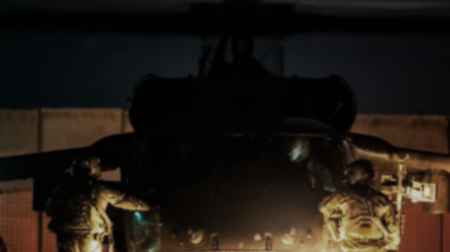
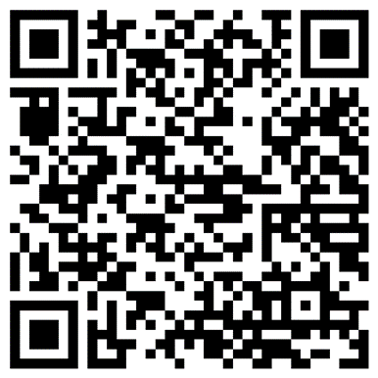

FORT BRAGG WARRANT OFFICER RECRUITING BRIEF
The U.S. Army Warrant Officer Recruiting Team will be in your area to conduct briefings on qualification and application procedures to become an Army Warrant Officer.
DATE & TIME | LOCATION
Thursday, April 2nd, 2026 @ 1330 - 1430 | Education Center Room E-115 4520 Knox St. Fort Bragg, NC 28310
POINTS OF CONTACT
CW2 ENSINGER: william.b.ensinger.mil@army.mil - (910) 308-0680
SSG AJ ROTZ: Alexander.j.rotz.mil@army.mil - (910) 551-1004
SSG ADEJIA FANE: adejia.i.fane.mil@army.mil - (931) 250-2159
SCAN THE QR CODE TO GET STARTED AND GET IN CONTACT WITH A RECRUITER TODAY.
JOIN THE ELITE

Slide 2
FORT BRAGG WARRANT OFFICER RECRUITING BRIEF
The U.S. Army Warrant Officer Recruiting Team will be in your area to conduct briefings on qualification and application procedures to become an Army Warrant Officer.
DATE & TIME | LOCATION
Thursday, April 16th, 2026 @ 1330 - 1430 | Education Center Room E-115 4520 Knox St. Fort Bragg, NC 28310
POINTS OF CONTACT
CW2 ENSINGER: william.b.ensinger.mil@army.mil - (910) 308-0680
SSG AJ ROTZ: Alexander.j.rotz.mil@army.mil - (910) 551-1004
SSG ADEJIA FANE: adejia.i.fane.mil@army.mil - (931) 250-2159
SCAN THE QR CODE TO GET STARTED AND GET IN CONTACT WITH A RECRUITER TODAY.
JOIN THE ELITE

Slide 3
FORT BRAGG WARRANT OFFICER RECRUITING BRIEF
The U.S. Army Warrant Officer Recruiting Team will be in your area to conduct briefings on qualification and application procedures to become an Army Warrant Officer.
DATE & TIME | LOCATION
Thursday, April 30th, 2026 @ 1330 - 1430 | Education Center Room E-115 4520 Knox St. Fort Bragg, NC 28310
POINTS OF CONTACT
CW2 ENSINGER: william.b.ensinger.mil@army.mil - (910) 308-0680
SSG AJ ROTZ: Alexander.j.rotz.mil@army.mil - (910) 551-1004
SSG ADEJIA FANE: adejia.i.fane.mil@army.mil - (931) 250-2159
SCAN THE QR CODE TO GET STARTED AND GET IN CONTACT WITH A RECRUITER TODAY.
JOIN THE ELITE

