Slide 1
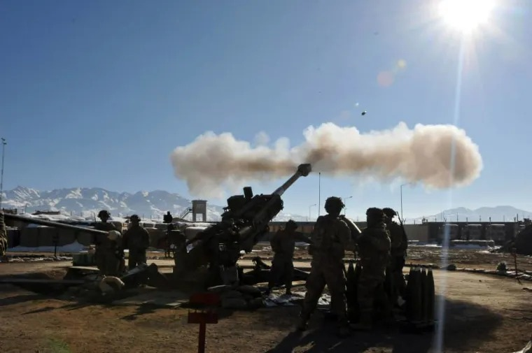

JANUARY FORT LEE, VA
WARRANT OFFICER RECRUITING BRIEF
The U.S. Army Warrant Officer Recruiting Team will be in your area to conduct briefings on qualification and application procedures to become an Army Warrant Officer.
DATE & TIME LOCATION
January 13, 2026
1300 - 1430
Fort Lee Education Center
700 Quarters Road
BLDG 12400
Fort Lee, VA 23801
POINT OF CONTACT
CW2 Ensinger, William - (910) 308 - 0680 - william.b.ensinger.mil@army.mil
SSG Rotz, Alexander - (910) 551 - 1004 - alexander.j.rotz.mil@army.mil
SSG Fane, Adejia - (931) 250 - 2159 - adejia.i.fane.mil@army.mil

