Slide 1
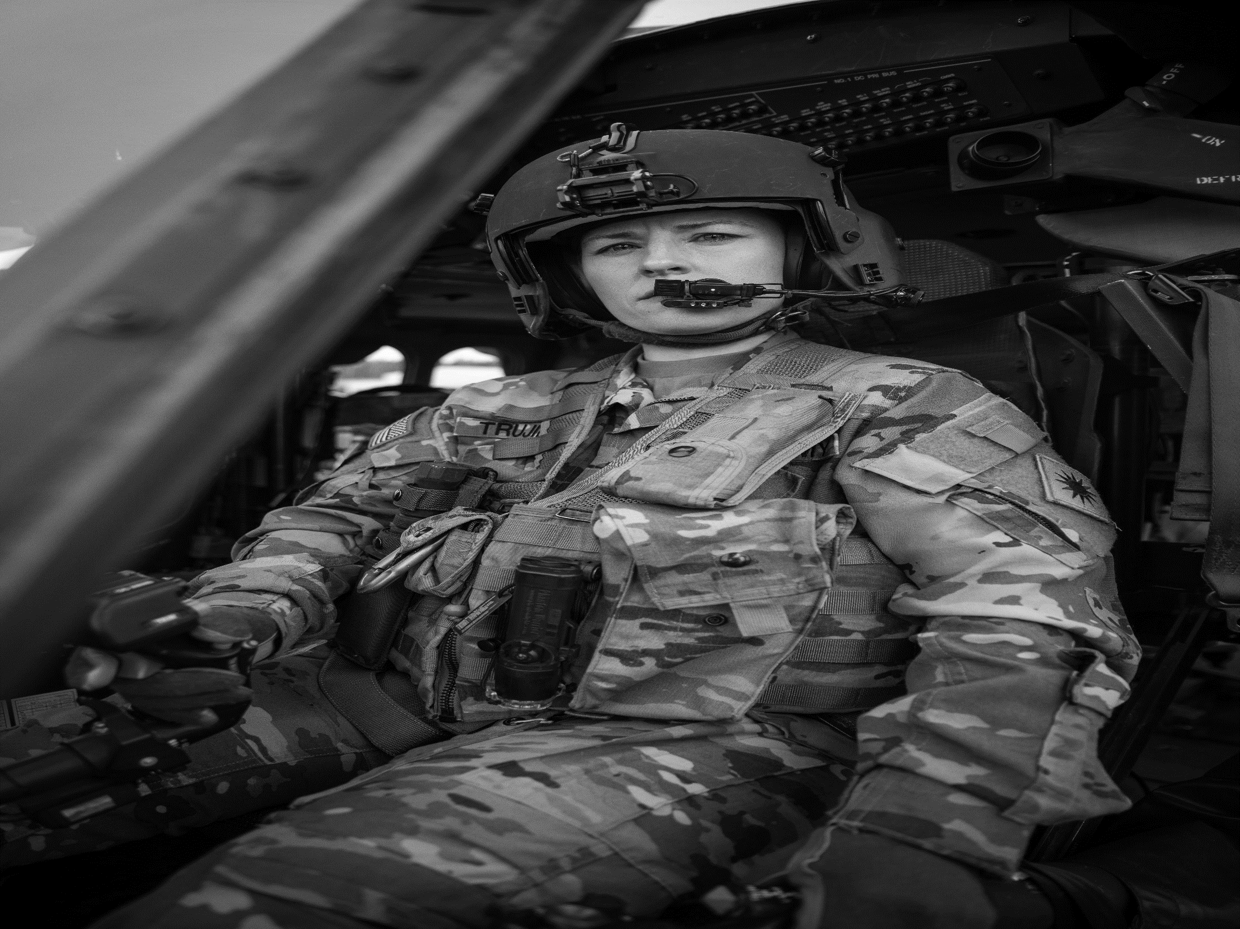
FORT JOHNSON
U.S. ARMY WARRANT OFFICER
BRIEFINGS
The U.S. Army Warrant Officer Recruiting Team will conduct briefings on FORT JOHNSON. Briefings will cover the qualification and application procedures to become an Army Warrant Officer.
DATE & TIME
11 MAR 2025
@1000 and 1330
LOCATION
Fort Johnson Library and Education Center
Room 105 , 7640 Colorado Ave, Fort Johnson LA
POINT OF CONTACT
CW3 Jamal Polite – jamal.d.polite.mil@army.mil - 502-999-4750
SFC Tamara Robinson – tamara.j.robinson6.mil@army.mil - 912-755-8825
SFC Nathaniel Wahl - nathaniel.c.wahl.mil@army.mil - 254-227-7491

