Slide 1
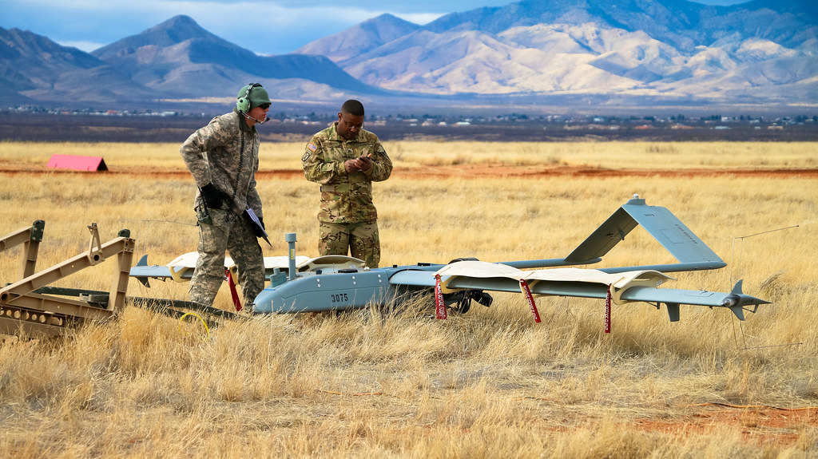
FORT HUACHUCA
U.S. ARMY WARRANT OFFICER
BRIEFING
The U.S. Army Warrant Officer Recruiting Team will be in your area to conduct briefings on qualification and application procedures to become an Army Warrant Officer.
DATE & TIME LOCATION
9 JUL 2025 @ 1300-1530 Cochise Classroom BLDG 52104 @ 2288 LaGuardia St,
Fort Huachuca AZ, 85613
POINT OF CONTACT
CW3 Jamal Polite – jamal.d.polite.mil@army.mil - 502-999-4750
SFC Tamara Robinson – tamara.j.robinson6.mil@army.mil - 912-755-8825
SFC Nathaniel Wahl - nathaniel.c.wahl.mil@army.mil - 254-227-7491

