Slide 1
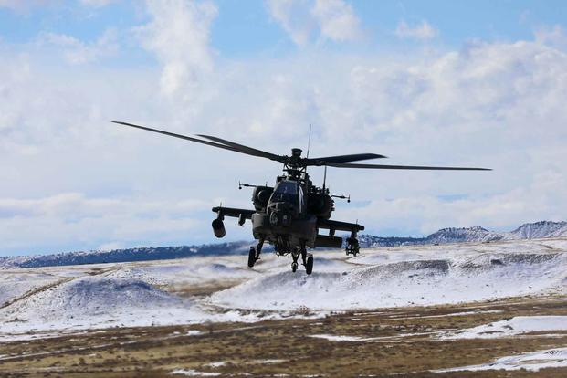
FORT CARSON
U.S. ARMY WARRANT OFFICER
BRIEFINGS
The U.S. Army Warrant Officer Recruiting Team will visit Fort Carson to conduct briefings on qualification and application procedures to become an Army Warrant Officer.
DATE & TIME
6 MAR 2025@ 1000 & 1400
LOCATION
Fort Carson Education Center
Room 300, 1675 Long St #1117 Fort Carson, CO
POINT OF CONTACT
CW3 Jamal Polite – jamal.d.polite.mil@army.mil - 502-999-4750
SFC Tamara J. Robinson – tamara.j.robinson6.mil@army.mil - 912-755-8825
SSG Nathaniel Wahl - nathaniel.c.wahl.mil@army.mil - 254-227-7491

