Slide 1
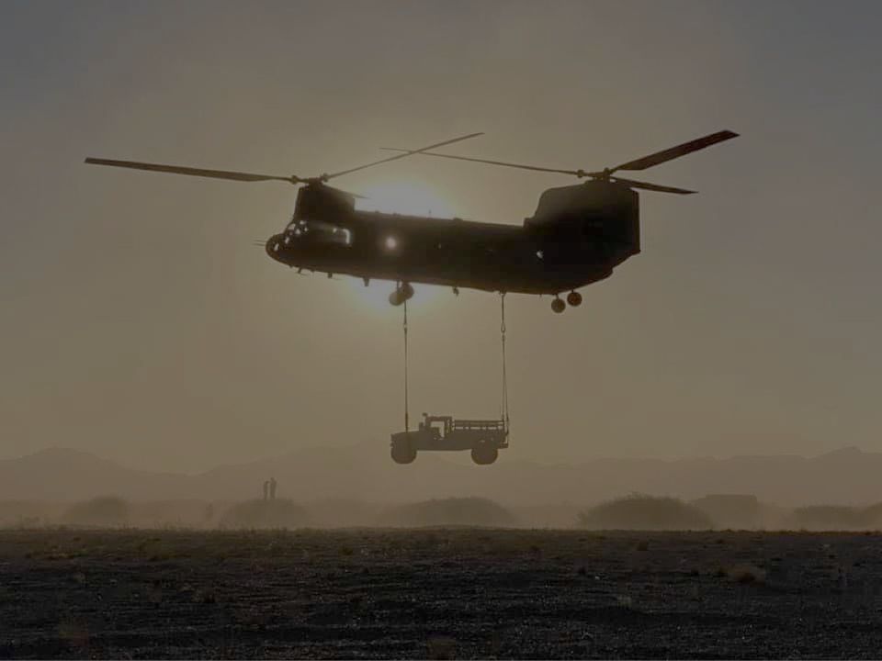
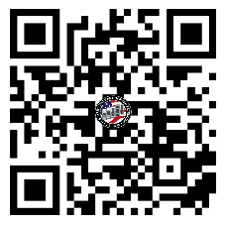
EAST REGION VIRTUAL
U.S. ARMY WARRANT OFFICER
BRIEFING
The U.S. Army Warrant Officer Recruiting Team will be conducting virtual briefings on qualification and application procedures to become an Army Warrant Officer.
DATE & TIME MS Teams Link
12 AUG 2025 @ 1330 EST
Dial In By Phone
+1 571 - 616 - 7941
Conference ID:
136 393 545#
Join the meeting now
Meeting ID: 993 402 736 848
Passcode: U6Fk7iQ6
Packet Process:
POINT OF CONTACT
CW3 Rodriguez, Rolando (910) 200-5191- rolando.v.rodriguez2.mil@army.mil
WO1 Paige, Johnnie - (910) 308 - 0680 - johnnie.m.paige.mil@army.mil

