Slide 1
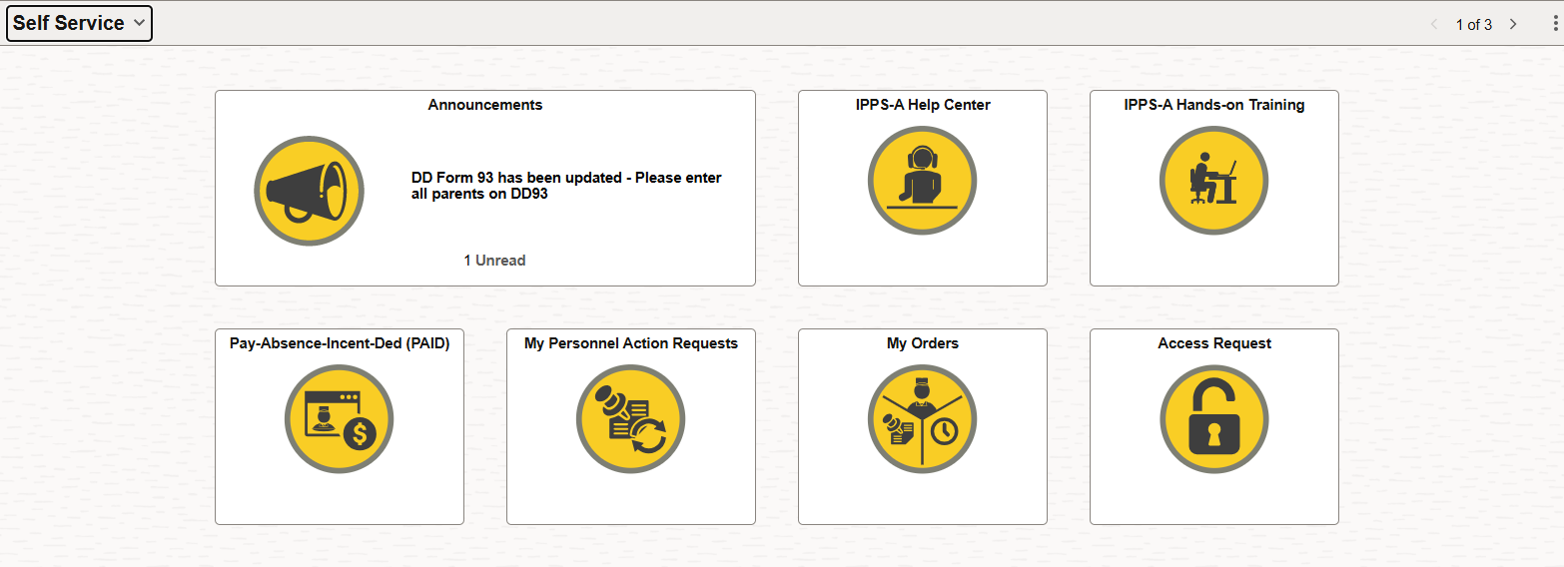
Step 1: Once logged into IPPS-A, navigate to Self Service and select 'My Personnel Action Request’.
Step 2: Select ‘Create Personnel Action’.

Slide 2
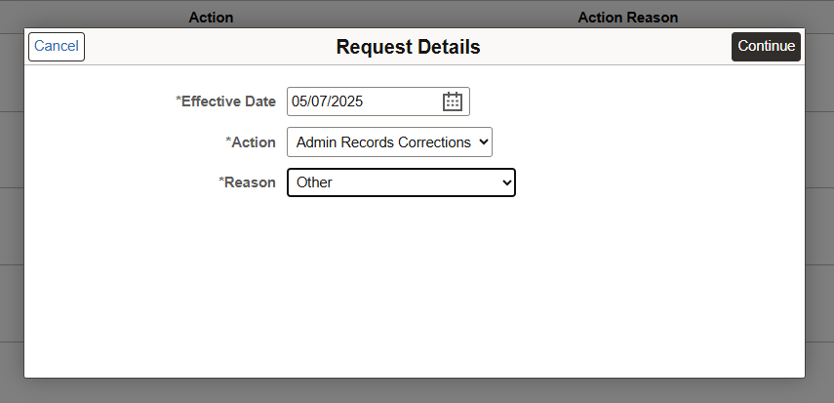
Step 3:
1. Effective Date- Date the PAR is being created
2. Action- Admin Records Corrections
3. Reason- Other

Slide 3
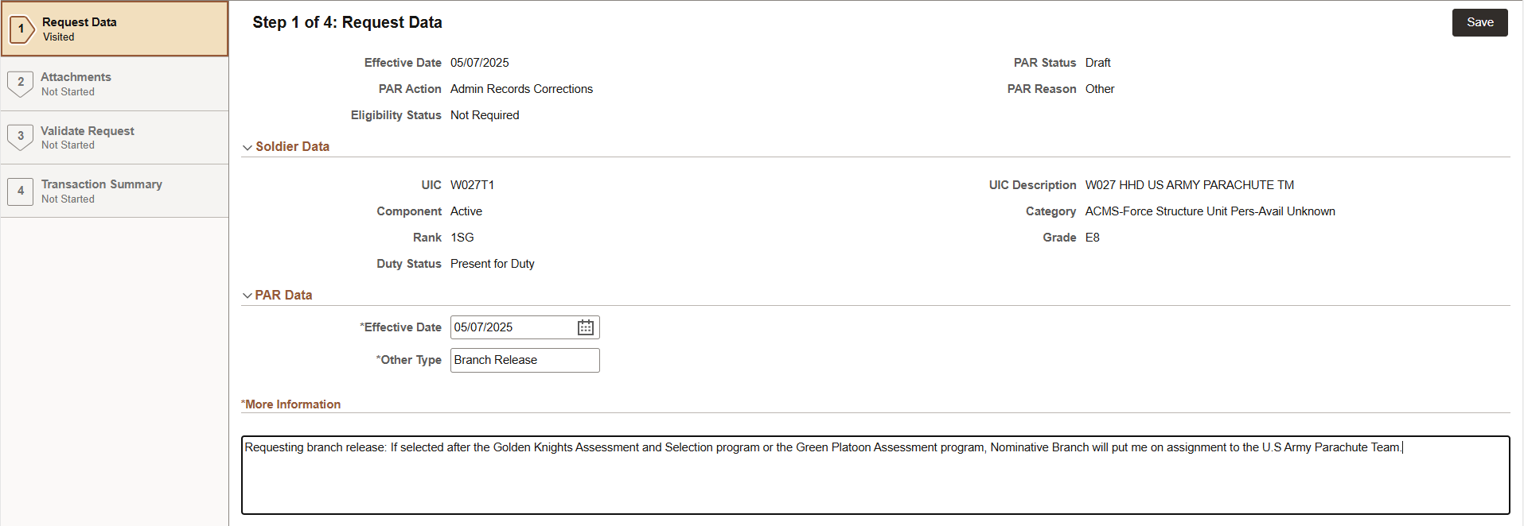
Step 4:
1. Other Type- Branch Release
2. More Information- Requesting branch release: If selected after the Golden Knights Assessment and Selection program or the Green Platoon Assessment program, Nominative Branch will put me on assignment to the U.S Army Parachute Team.

Slide 4
Step 5: No supporting documents needed
Step 6: Validate

Slide 5
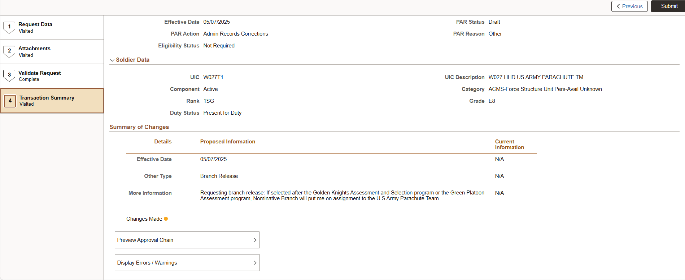
Step 7: Submit
After selecting 'Submit,' the request should be routed to your S1. The S1 will then process it through the appropriate unit routing. Once approved, the S1 will forward it to the Nominative Branch UDL 000000000040203, which will then route it to the appropriate branch manager.

