Slide 1
AMEDD Commissioning
Brief

Slide 2
AMEDD Commissioning Programs
Agenda
Interservice Physician Assistant Program (IPAP)
AMEDD Enlisted Commissioning Program (AECP)
Army-Baylor Occupational Therapy Doctorate Program (OTD)
Army-Baylor Doctoral Program in Physical Therapy (DPT)
Army-Baylor Master’s Program in Nutrition (MPN)
Army-University of Kentucky Master’s in Social Work Program (MSW)
Enlisted to Medical Degree Preparatory Program (EMDP2)
Health Professions Scholarship Program (HPSP)
Tuition Assistance (TA) Eligibility
Notes:
Purpose: Educate Soldiers and Leaders on the educational opportunities offered by the AMEDD.

Slide 3
U.S. Army Recruiting Command
Fort Knox, KY
MAJ Jason Sharp, IPAP Program Manager
MAJ Abby Steiner, SP Corps Program Manager
MAJ Damalie Musoke, AECP Program Manager
SFC Gary Horne, AECP Administrator
3

Slide 4
Interservice Physician Assistant Program (IPAP)
Starting Point
Research the professions
Meet with someone in the profession
Discuss the options with your family and friends (your support during the training)
Meet with your education center counselor about your educational goals, aspirations and paths
4

Slide 5
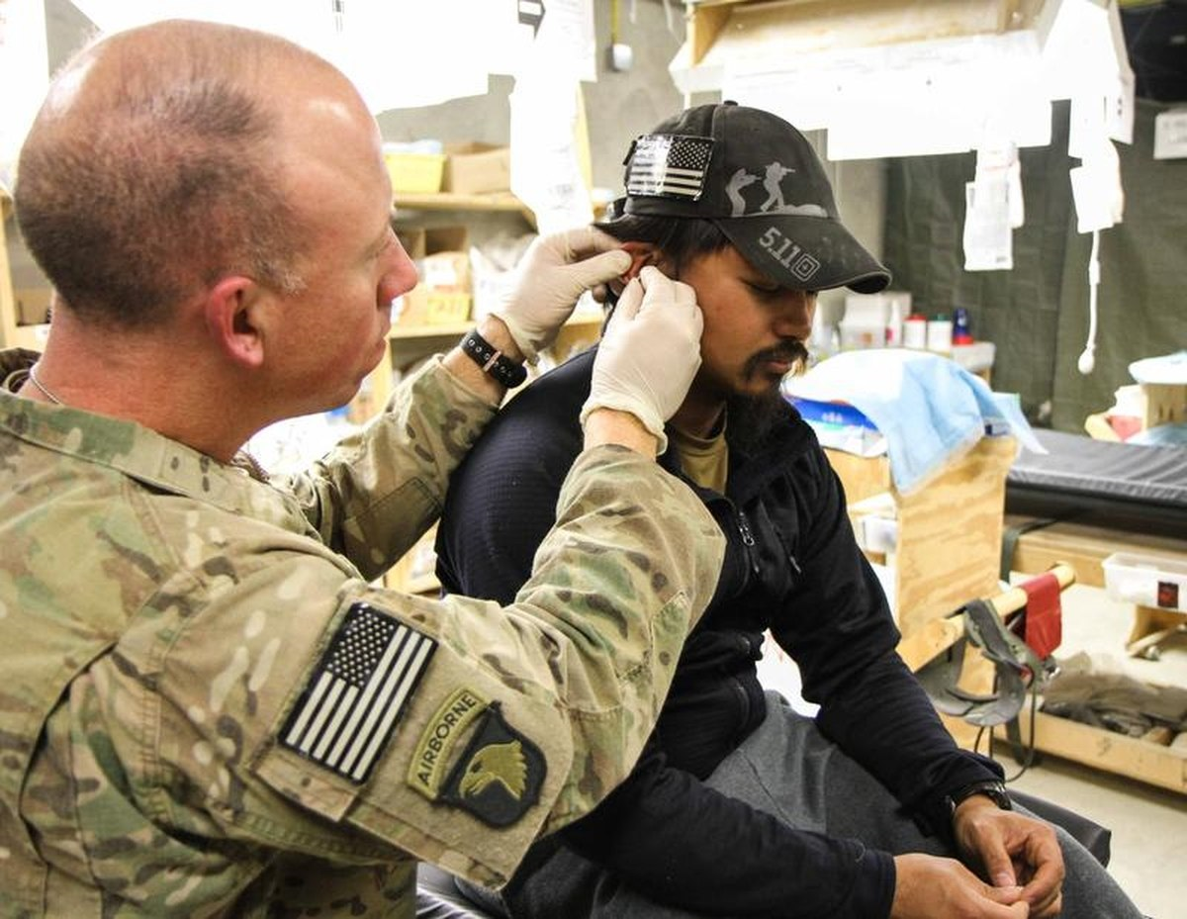
Interservice Physician Assistant Program (IPAP)
What is an Army PA?
Military health care professional certified to practice medicine with physician supervision
The AMEDD’s primary medical provider in battalion and division level TO&E units “From the Line, For the Line”
ROLE I/II Subject Matter Expert
Duties of an Army PA
Provide advanced trauma management
Conduct physical exams
Diagnose and treat illnesses
Order and interpret diagnostic tests
Counsel on preventive health care
Assist in surgery
Write prescriptions

Slide 6
Interservice Physician Assistant Program (IPAP)
Read MILPER Message
AR 601-20, The IPAP Program Regulation
Army Physician Assistant (afpims.mil)
IPAP Dual Application Window:
1OCT - 1MAR
JUNE:
Board Convenes
JULY:
Board Results published via
MILPER Message
Class Start:
- JAN
- APR
- AUG
TA Memo:
To cover Course Pre-requisites
https://unmcredcap.unmc.edu/redcap/surveys/?s=C7HYXDKTR
SAT
Last Test Date: 8 MAR
w/in 5 years of application
PA-CAT
No minimum score
Due NLT 1 MAR
Transcripts
NLT 1MAR
Combined Score: 1,000 / Reading: 450 / Math: 450
Reimbursement via COOL
Academic Delay: up to (3) classes
Website: https://recruiting.army.mil/armypa/

Slide 7
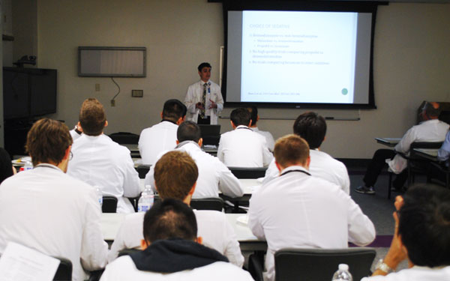
Interservice Physician Assistant Program (IPAP)
IPAP Phase 1 – Didactic Phase
66 weeks at Joint Base San Antonio
2,400 Contact Hours (classroom) – A&P, chemistry, pathology, radiology, pharmacology, psychiatry, OB/GYN, orthopedics, infectious disease, etc.
Very Challenging but anything worth having is!

Slide 8
Interservice Physician Assistant Program (IPAP)
IPAP Phase 2 – Clinical Phase
15 Different Clinical Sites
57 Weeks in duration
Clinical Rotations include:
Family Medicine/Primary Care
Internal Medicine
Ophthalmology
Psychiatry
Dermatology
OB/GYN
Orthopedics
Surgery
Emergency Medicine
ENT/Allergy

Slide 9
Interservice Physician Assistant Program (IPAP)
Phase II Sites:
Fort Moore
Fort Belvoir
Fort Bliss
Fort Liberty
Fort Campbell
Fort Carson
Fort Eisenhower
Fort Cavazos
Fort Leonardwood
Fort Riley
Fort Stewart
Joint Base Lewis-McChord
Joint Base San Antonio
Landstuhl Regional Medical Center
Tripler
West Point
Walter Reed
By exception only:
Air Force locations

Slide 10
Interservice Physician Assistant Program (IPAP)
Basic Qualifications:
ROTC Cadets, while in cadet status, are not eligible
USAR IPAP seats are only open for USAR Soldiers
Active-Duty IPAP seats are only open to Active-Duty Soldiers
Other services can only apply to IPAP through their branches - https://medcoe.army.mil/ipap-prospective-student-students

Slide 11
Interservice Physician Assistant Program (IPAP)
ALL Applicants:
No DA photo
ACFT (or Army Fitness test of record) score card required for all components
Height and Weight IAW AR 600-9 (no 540+ excemptions)
Qualified for appointment IAW AR 601-100, and AR 40-501/DODI 6130.03
Soldier Talent Profile (STP) must be certified true copy from your Commander or 1SG
Command and Branch Release required (PAR in IPPS-A) – Command is required to apply and Branch is required AFTER selection → (AD Only)
Security Clearance Verification Memo

Slide 12
Interservice Physician Assistant Program (IPAP)
IPAP Specific Application Documents:
Online application through UNICAS at http://ipap.liaisoncas.com
This is REQUIRED
Same deadline of 1 March
Curriculum Vitae
DA Form 160 with dates of desired class priority preference:
January/April/August
Officers DA 71 Oath of Office and Appointment Letter
Submit application digitally
PDF documents as outlined on the Application Summary Sheet
usarmy.knox.usarec.mbx.hsd-ipap@army.mil

Slide 13
Interservice Physician Assistant Program (IPAP)
Other Administrative Requirements:
DA 61
NCOER’s/OER’s
1059’s
Awards (include narrative)
Professional training certificates
DD214
Letter of Character from 1SG (recommended if applicant has no NCOER’s)

Slide 14
Interservice Physician Assistant Program (IPAP)
Enlisted Applicant Requirements
GT Score 110+ (No waiver)
Physical must meet accession IAW 40-501 Ch. 2 and DODI 6130.03
May be retainable in the Army but not able to attend the program if not commissionable
Just as competitive as an officer
Even if you are not in the medical field, you are competitive

Slide 15
Interservice Physician Assistant Program (IPAP)
Letter of Intent (LOI):
Very important!
LOI must be typed, recommend one page
Express to board your desire to be an AMEDD Officer
Board uses the LOI to evaluate your writing abilities
Have more than one person review your LOI
Be sure to sign it!

Slide 16
Interservice Physician Assistant Program (IPAP)
Letters of Recommendation:
Required from:
First Line Supervisor
Commander (BN or above)
Officer of the profession (Use USAREC Form 601-37.11 with NEW supplemental digital document. MUST include documentation of 80+ shadowing hours)
Maximum of 5 letters
May use USAREC Form 601-37.11
May use Memorandum format
Addressed to the board

Slide 17
Interservice Physician Assistant Program (IPAP)
Commissioning Physical:
Dated after 7 June - (No older than 12 months from board date)
DD 2807-1 and DD 2808
Must include ETOH, Drug Screen, HIV, UA, HCG test in lab printout
P3 profiles are ineligible (No Waiver)

Slide 18
Interservice Physician Assistant Program (IPAP)
Educational/ Academic Requirements - SAT
Must have SAT within 5 years of application deadline (take NLT 8 Mar 25)
Required from ALL applicants – No waiver
Minimum Score requirements
Combined Math and Reading – equal to 1000 or higher
Reading – equal to 450 or higher
Math – equal to 450 or higher
SAT Improvement Program
www.eknowledge.com/militaryhomefront

Slide 19
Interservice Physician Assistant Program (IPAP)
Educational/ Academic Requirements – PA-CAT
Must have PA-CAT taken by application deadline (1 March)
Required from ALL applicants – No waiver
Currently No Minimum Score requirements
Registration at www.pa-cat.com
Credentialling assistance information available on IPAP website (recruiting.army.mil/armypa)

Slide 20
Interservice Physician Assistant Program (IPAP)
Educational/Academic Requirements
Grade Point Averages – Waiverable
NO Grade Replacement
Overall GPA MUST be 2.5 or greater
Derived from official transcripts of ALL schools ever attended
Science GPA MUST be 3.0 or greater
Science classes taken within the last 8 years
List of science classes included in Science GPA on website
New ‘Highest’ science GPA allowed for retaken classes (only same class
from same school)

Slide 21
Interservice Physician Assistant Program (IPAP)
Course Prerequisites (No Waiver):
60 semester hours
The following 30 semester hours must be in accredited class or internet (online) course with a letter grade of C or better. You MAY NOT use MOS, CLEP (except ENG), DANTES to satisfy the following requirements:
6 hours English (3SH Writing/Composition) – CLEP with score of 50
6 hours Humanities – Ex. Social Studies, Government, History, Art, Language, etc.
3 hours of Psychology (any type)
3 hours of College Algebra or higher math (NOT intro or intermediate) CLEP with score of 50
6 hours Chemistry (general or higher) * 8 year maximum
Intro to Chemistry is NOT acceptable
3 hours Anatomy and Physiology I or Anatomy (Human) * 8 year maximum
Intro classes are acceptable
Cannot mix classes (A&Ps or Anatomy/Physiology)
Added AOC/MOS/ASIs for applied A&P credit
3 hours Anatomy and Physiology II or Physiology (Human) * 8 year maximum
3 Medical Terminology * 5 year maximum
Can take on Army Training Information System (ATIS)

Slide 22
Interservice Physician Assistant Program (IPAP)
Academic Delay:
May apply with 3 required courses or less (9 SH or less) in progress after application deadline (1 March)
Coursework must be complete NLT 1 October
If selected with an academic delay:
Slot for attendance is guaranteed IF you complete all courses by NLT 1 October
Must reapply the following year if not selected

Slide 23
Interservice Physician Assistant Program (IPAP)
Waivers:
Time in Service:
All applicants less than 3 years time in service
All Officers – over 8 years
Reserve Applicants – over 10 years
Active Duty Enlisted – over 15 years
Convictions: (if you answered yes to block #26 on DA 61)
Include ALL court documents and outcome
Includes convictions prior to entering the service
A letter of support from your Chain of Command is looked at favorably
Medical: (IAW AR 40-501 and DODI 6130.03)
Include consult and recommendation from appropriate clinician

Slide 24
Interservice Physician Assistant Program (IPAP)
Waivers:
Age:
All Active Duty applicants over 42 years of age at expected graduation
All USAR applicants over 47 years of age at expected graduation
Profiles:
All applicants with P2 profile (except hearing and eyes) are ineligible
Permanent profiles with a 2 in PULHES for P, H, E may request exception to board. Considered on a case-by-case basis.
Permanent profiles with a 2 in PULHES for U, L, S are not eligible to board.
Temporary Profiles – ineligible to board. May request exception to board and will be considered on a case-by-case basis.
P3 profiles are ineligible (Non-waiverable)

Slide 25
Interservice Physician Assistant Program (IPAP)
Rank (Enlisted)
Everyone accumulates months towards promotion during school
All Enlisted Applicants must successfully complete the Basic Leader Course (BLC) prior to the start of IPAP
E-4 and below will be paid as E-5
E-5 and above maintain their pay grade
All wear “OCS”
Graduate as 1LT with 2 years of constructive credit, eligible for CPT in 30 months

Slide 26
Interservice Physician Assistant Program (IPAP)
Rank (Officer)
All Officers and WOs who are primary zone promotion non-selects require a waiver to apply.
Officers will be ‘detailed’ to the SP branch
Remain in their own basic branch
Rank adjustments completed IAW DODI 6000.13 upon successful completion of IPAP
Warrant Officers attend school wearing Warrant Officer rank

Slide 27
Interservice Physician Assistant Program (IPAP)
Degree and ADSO
Bachelor of Science Degree from the University of Nebraska at end of Phase 1
Master’s Degree in Physician Assistant Studies from the University of Nebraska upon completion of 29 month program
Active Duty Service Obligation (ADSO) – 54 months
USAR 6 years SELRES + 2 years IRR

Slide 28
Interservice Physician Assistant Program (IPAP)
Endpoint
Master’s Degree in 29 months
Army Officer
Accelerated first promotion
Great Military and Civilian Career
Continue to serve this great country!

Slide 29
Interservice Physician Assistant Program (IPAP)
Questions?
IPAP Mailbox
usarmy.knox.usarec.mbx.hsd-ipap@mail.mil
MAJ Jason Sharp Jenny Gustafson
jason.n.sharp.mil@army.mil jenny.l.Gustafson.civ@army.mil

Slide 30
AMEDD Enlisted Commissioning Program (AECP)
The AECP affords eligible enlisted
Soldiers the opportunity to complete
a Bachelor of Science degree in
Nursing (BSN), become a Registered
Nurse, and commission as an 2LT in
the Army Nurse Corps. Active Duty
Service Obligation (ADSO) for the
Program completion is 4 years

Slide 31
AMEDD Enlisted Commissioning Program (AECP)
AECP website: https://recruiting.army.mil/aecp/
USARMY Ft Knox USAREC Mailbox HSD Enlisted Commissioning Program usarmy.knox.usarec.mbx.hsd-enlisted-commissioning-program@army.mil
MAJ Damalie Musoke
Program Manager
damalie.n.musoke.mil@army.mil
SFC Gary Horne
NCOIC
Gary.v.hrone.mil@army.mil
31

Slide 32
AMEDD Enlisted Commissioning Program (AECP)
AECP Program Information
MILPER Message 24-016 FY24 AMEDD Enlisted Commissioning Program (AECP) and USAREC Guidelines at https://recruiting.army.mil/aecp/
MILPER 24-021 Amendment to MILPER 24-016. (Add increased to 37.5 years old)
Nursing school must have the last 3 years NCLEX pass rate of 90% or higher (Example: 2021: 91%, 2022: 95%, 2023: 98%) (not average)
ACEN (Accreditation Commission for Education in Nursing) or CCNE (Commission on Collegiate Nursing Education).
The nursing program must be completed within 24 months. Accelerated programs are authorized and encouraged
Be within 100 miles of Military Treatment Facility
Offer In-State Tuition to applicants
Each academic year, the school cannot charge more than $15,000. $1000 book stipend authorized for 2 academic years
While in school, the Soldier will be assigned to the 187th Army Student Detachment, San Antonio, TX with physical duty location at the nursing school
Notes:
No waivers for program eligibility

Slide 33
AMEDD Enlisted Commissioning Program (AECP)
Soldier Eligibility
E4 promotable with BLC complete by deadline (not waiverable)
GT score 110 or higher (not waiverable)
Approved commissioning physical (completed with recruiter)
Minimum GPA 3.0 (waiverable)
No older than 37.5 years old at start of nursing school (waiverable)
Minimum 4 years TIS (waiverable)
Max 12 years TIS (waiverable)
See MILPER and Guidelines for additional information
Notes:
No waivers for program eligibility

Slide 34
AMEDD Enlisted Commissioning Program (AECP)
How to get started
Apply to nursing school and completed all required prerequisites.
Received a letter of acceptance from nursing school.
Build AECP packet using the AECP checklist
Contact an AMEDD recruiter.
CV submission deadline 1 August 2024; Packet Deadline 23 August 2024
If selected, start school between May-September of 2025. (No January starts authorized)
See MILPER and Guidelines for additional information
Notes:
No waivers for program eligibility

Slide 35
AMEDD Enlisted Commissioning Program (AECP)
Tips To Be a Competitive Applicant:
GPA
Previously conferred degree
Healthcare Licenses / Certifications
Unconditional letter of acceptance vs. Conditional Letter
Accepted into more than 1 nursing school
Letters of recommendation
Letter of intent / writing skills
CV (resume)
Physical fitness test
Moral/legal/convictions/UCMJ issues
Soldier Talent Profile (STP) formerly SRB

Slide 36
AMEDD Enlisted Commissioning Program (AECP)
Questions?

Slide 37
AMEDD Commissioning Programs
Big Changes to the GRE Starting FY24!
Education Testing Service (ETS) announce major changes to the Graduate Record Examination (GRE) effective Sept 2023
GRE testing time reduced by half, from four hours to just under two hours
Official GRE score turnaround time reduce from 10-15 days to 8-10 days
GRE will still have the same three measures (Verbal, Quantitative, & Analytical Writing), same question types, and same score scales
The following AMEDD Programs require the GRE:
Army-Baylor University OTD
Army-Baylor University DPT
Army-Baylor University MPN
Army-University of Kentucky MSW
https://www.ets.org/gre.html
Notes:
effective 22 SEP 2023

Slide 38
Notes:
Army Field Manual 7-22, along with the H2F Operating Concept, provides the framework for H2F. H2F focuses on five physical and non-physical domains to achieve the Army’s readiness goals and are based on the principles of optimization, individualization, and immersion. These domains are physical readiness, nutritional readiness, mental readiness, spiritual readiness, and sleep readiness. The goal is to improve each Soldier’s physical lethality and mental toughness through the linking of the five H2F domains across the physical and non-physical aspects of health and fitness.

Slide 39
Army-Baylor University AMEDD Programs
MILPER 23-245 FY 2024 Army-Baylor DPT Application Procedures
MILPER 23-246 FY 2024 Army-Baylor MPN Application Procedures
MILPER 23-247 FY 2024 Army-Baylor OTD Application Procedures

Slide 40
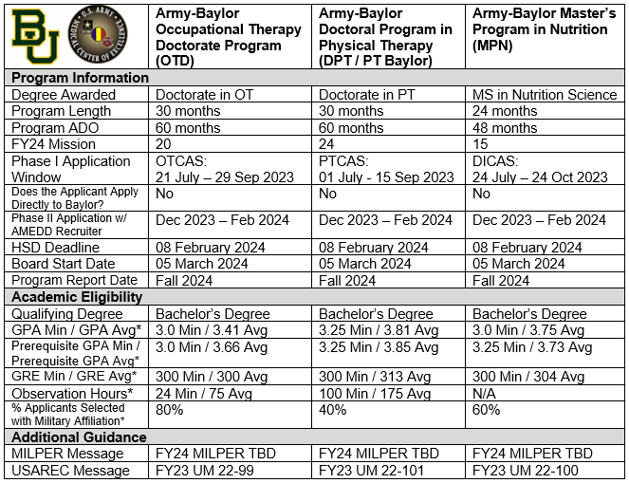
Army-Baylor Program Comparison
*Averages based on Primary Selects from FY23 Board Results
Notes:
DPT Website: https://military.robbins.baylor.edu/entry-level-otd
Program Email: armybaylorOTD@baylor.edu
OTD Website: www.baylor.edu/graduate/pt
Program Email: armybaylordpt@baylor.edu
MPN Website: www.baylor.edu/graduate/nutrition
Program Email: medcoempn@army.mil

Slide 41
Army-Baylor Program TIMELINE
Army-Baylor OTD/DPT/MPN FY24 Timeline
Read MILPER & Apply: JUL – SEP/OCT 2023
Program Interviews:
SEP – NOV 2023
Academic Notification:
15 NOV 2023
Approved Applicants work w/ AMEDD Recruiter:
DEC – FEB 2024
USAREC HSD Deadline:
8 FEB 2024
USAREC Selection Board:
5–8 MAR 2024
Report To JBSA, TX:
AUG – NOV 2024
Army-Baylor Program Starts:
JAN 2025
OTCAS Application Window: 21 JUL – 29 SEP 2023
PTCAS Application Window: 01 JUL - 15 SEP 2023
DICAS Application Window: 24 JUL – 24 OCT 2023
Notes:
O/A August 2024: Non-prior service (NPS) and currently serving enlisted soldiers requiring both AMEDD DCC and BOLC report to JBSA, TX to in-process prior to report for DCC at Fort Sill, OK. O/A September 2024: Currently serving enlisted soldiers or officers exempt from AMEDD DCC requiring only BOLC report to JBSA, TX to in-process prior to report for BOLC. O/A 01 November 2024: Currently serving officers exempt from both AMEDD DCC and BOLC report directly to JBSA, TX as specified on PCS orders.

Slide 42
AMEDD Commissioning Program (MSW)
Army-University of Kentucky (UK)
Master of Social Work (MSW) Program
Read MILPER Message & Contact Local AMEDD Recruiter
Application Deadline to USAREC:
December
Board Convenes
January
Board Results are published
February
Application Window:
July - November
Report to AMEDD DCC:
July
(Ft. Sill, OK)
Report to JBSA, TX
- o/a August
AMEDD BOLC:
- O/A August
MSW Start Date:
- o/a January
Academic/Phase I:
14 Months
Academic/Phase II:
26 Months at an Army Medical Treatment Facility
Students incur a 42-month ADSO
See current MILPER MESSAGE for more information
Website: https://socialwork.uky.edu/academics/msw/army-msw-program
42

Slide 43
AMEDD Commissioning Program
Enlisted to Medical Degree Preparatory Program (EMDP2)
Resident training program to assist Soldiers to complete the requirements to apply to medical school
Two Years of Academics: George Mason University
MCAT Preparation
Shadowing with Physicians
Clinical experience & mentoring
Website: https://medschool.usuhs.edu/academics/emdp2
43
Notes:
The Enlisted to Medical Degree Preparatory Program (EMDP2) program is a two-year, full-time education program for enlisted members of the military. It is intended for motivated service members who show academic promise and whose experiences and goals align with the mission of their military services and the F. Edward Hebert School of Medicine. Selectees are assigned to USU (requires a permanent change of station to Bethesda, MD) and placed in a supportive academic setting for a two-year period.
EMDP2 includes premedical coursework, Medical College Admissions Test (MCAT) preparation, clinical experience, mentoring, and pre-health advising. George Mason University provides the coursework, MCAT preparation courses, and pre-health advising on a contract basis. These services are provided at Mason’s Science and Technology Campus (Manassas) in an exclusive cohort structure. USU coordinates the remaining elements, including the clinical component, which is completed at Fort Belvoir Community Hospital, Walter Reed National Military Medical Center, and Malcolm Grow Medical Center at Andrews Air Force Base.

Slide 44
AMEDD Commissioning Program
Health Professions Scholarship Program (HPSP)
Physician, Dentist, Veterinarian, Optometrist, Clinical or Counseling Psychologist Scholarship Program
Pays 100% Tuition, Books, monthly stipend (10.5 months)
School of your choice
Commissioned as 2LT in the IRR while in school
Commissioned as a CPT on AD upon graduation
Work with local AMEDD Recruiter to apply: https://www.goarmy.com/amedd.html
44
Notes:
The Health Professions Scholarship Program (HPSP) is one of the most comprehensive scholarships available in the health care field, covering your full tuition for an advanced medical degree while also providing you with a monthly stipend.

Slide 45
Army Continuing Education System
Tuition Assistance (TA) Eligibility
Must have approved TA memo from Program Manager
$4,000 combined for TA & CA per FY -TA amount: $250 per SH, $166 per QH -16SH per FY
Soldiers who are flagged are ineligible for TA
Have an ArmyIgnitED Account
Courses must be completed prior to ETS date
Meet program requirements such as GT Score, TIS, Age etc.

Slide 46
Questions?
Contact Your Local AMEDD Recruiter:
https://www.goarmy.com/amedd.html
46

