Slide 1
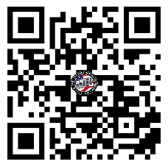
FORT GREGG-ADAMS
U.S. ARMY WARRANT OFFICER
BRIEFING
The U.S. Army Warrant Officer Recruiting Team will be in your area to conduct briefings on qualification and application procedures to become an Army Warrant Officer.
DATE & TIME LOCATION
Beaty Theater (The Theater Company)
4300 Sustanment Ave
FORT GREGG-ADAMS, VA 23801
Wednesday, February 26th, 2025
1000 - 1130
Packet Process:
POINT OF CONTACT
SFC Paige, Johnnie - (910) 308 - 0680 - johnnie.m.paige.mil@army.mil
SSG Rotz, Alexander - (910) 551-1004 - Alexander.j.rotz.mil@army.mil

