Slide 1
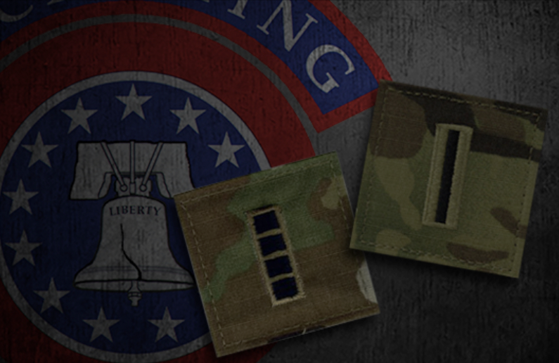

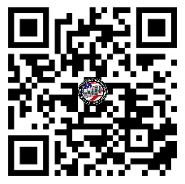
QUARTERLY FORT EUSTIS
U.S. ARMY WARRANT OFFICER
BRIEFING
The U.S. Army Warrant Officer Recruiting Team will be in your area to conduct briefings on qualification and application procedures to become an Army Warrant Officer.
DATE & TIME LOCATION
Wednesday, February 19th, 2025
1000 - 1130
Army Transportation Museum
300 Washington Blvd,
Fort Eustis, VA 23604
Packet Process:
POINT OF CONTACT
SFC Paige, Johnnie - (910) 308 - 0680 - johnnie.m.paige.mil@army.mil
SSG Rotz, Alexander - (910) 551-1004 - Alexander.j.rotz.mil@army.mil

