Slide 1
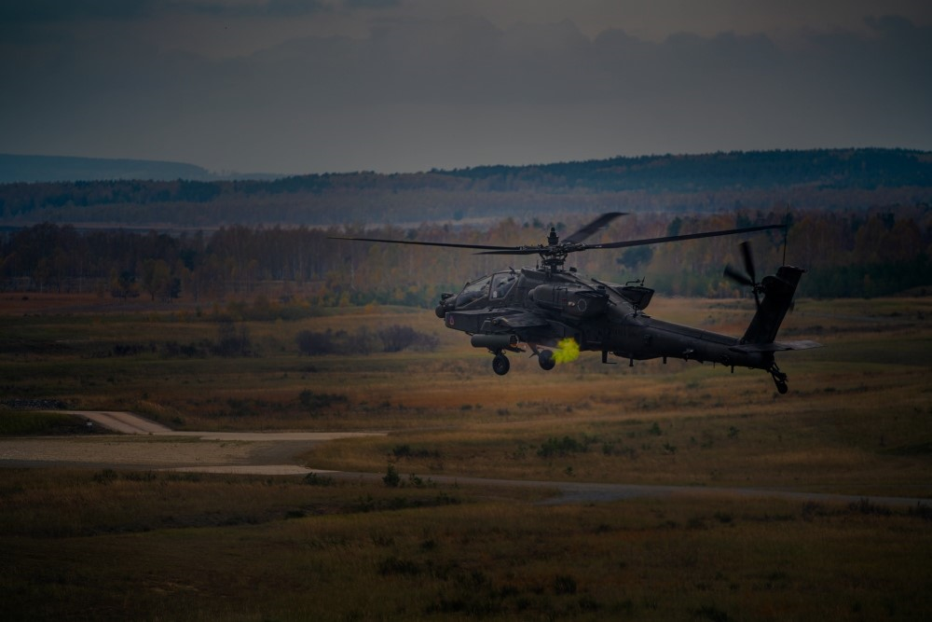
FORT BRAGG
Flight Warrant Day
(RSVP REQUIRED)
The U.S. Army Warrant Officer Recruiting Team is hosting a special event for aspiring Aviators! 🛩️ Join us to meet Flight Warrants and experience Flight Simulators for platforms such as CH-47F, UH-60M, and AH-64E. Don't miss this opportunity to take your career to new heights! 🚁
DATE & TIME LOCATION
April 1st, 2025
@
1200 - 1420
Simmons Army Airfield
(Google Maps) Across from “Flight Simulator
C Street, Fayetteville, NC 28311”
POINT OF CONTACT
SFC PAIGE, JOHNNIE M. – johnnie.m.paige.mil@army.mil - (910) 308 - 0680

Slide 2
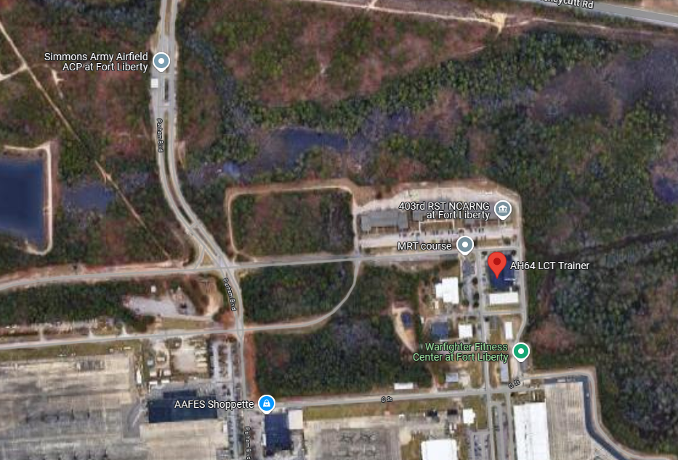
FORT BRAGG
Flight Warrant Day
(Limited Seats Available)
Simmons Army Airfield
(Google Maps) Across from “Flight Simulator
C Street, Fayetteville, NC 28311”
POINT OF CONTACT
SFC PAIGE, JOHNNIE M. – johnnie.m.paige.mil@army.mil - (910) 308 - 0680

